Slide 1
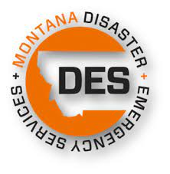
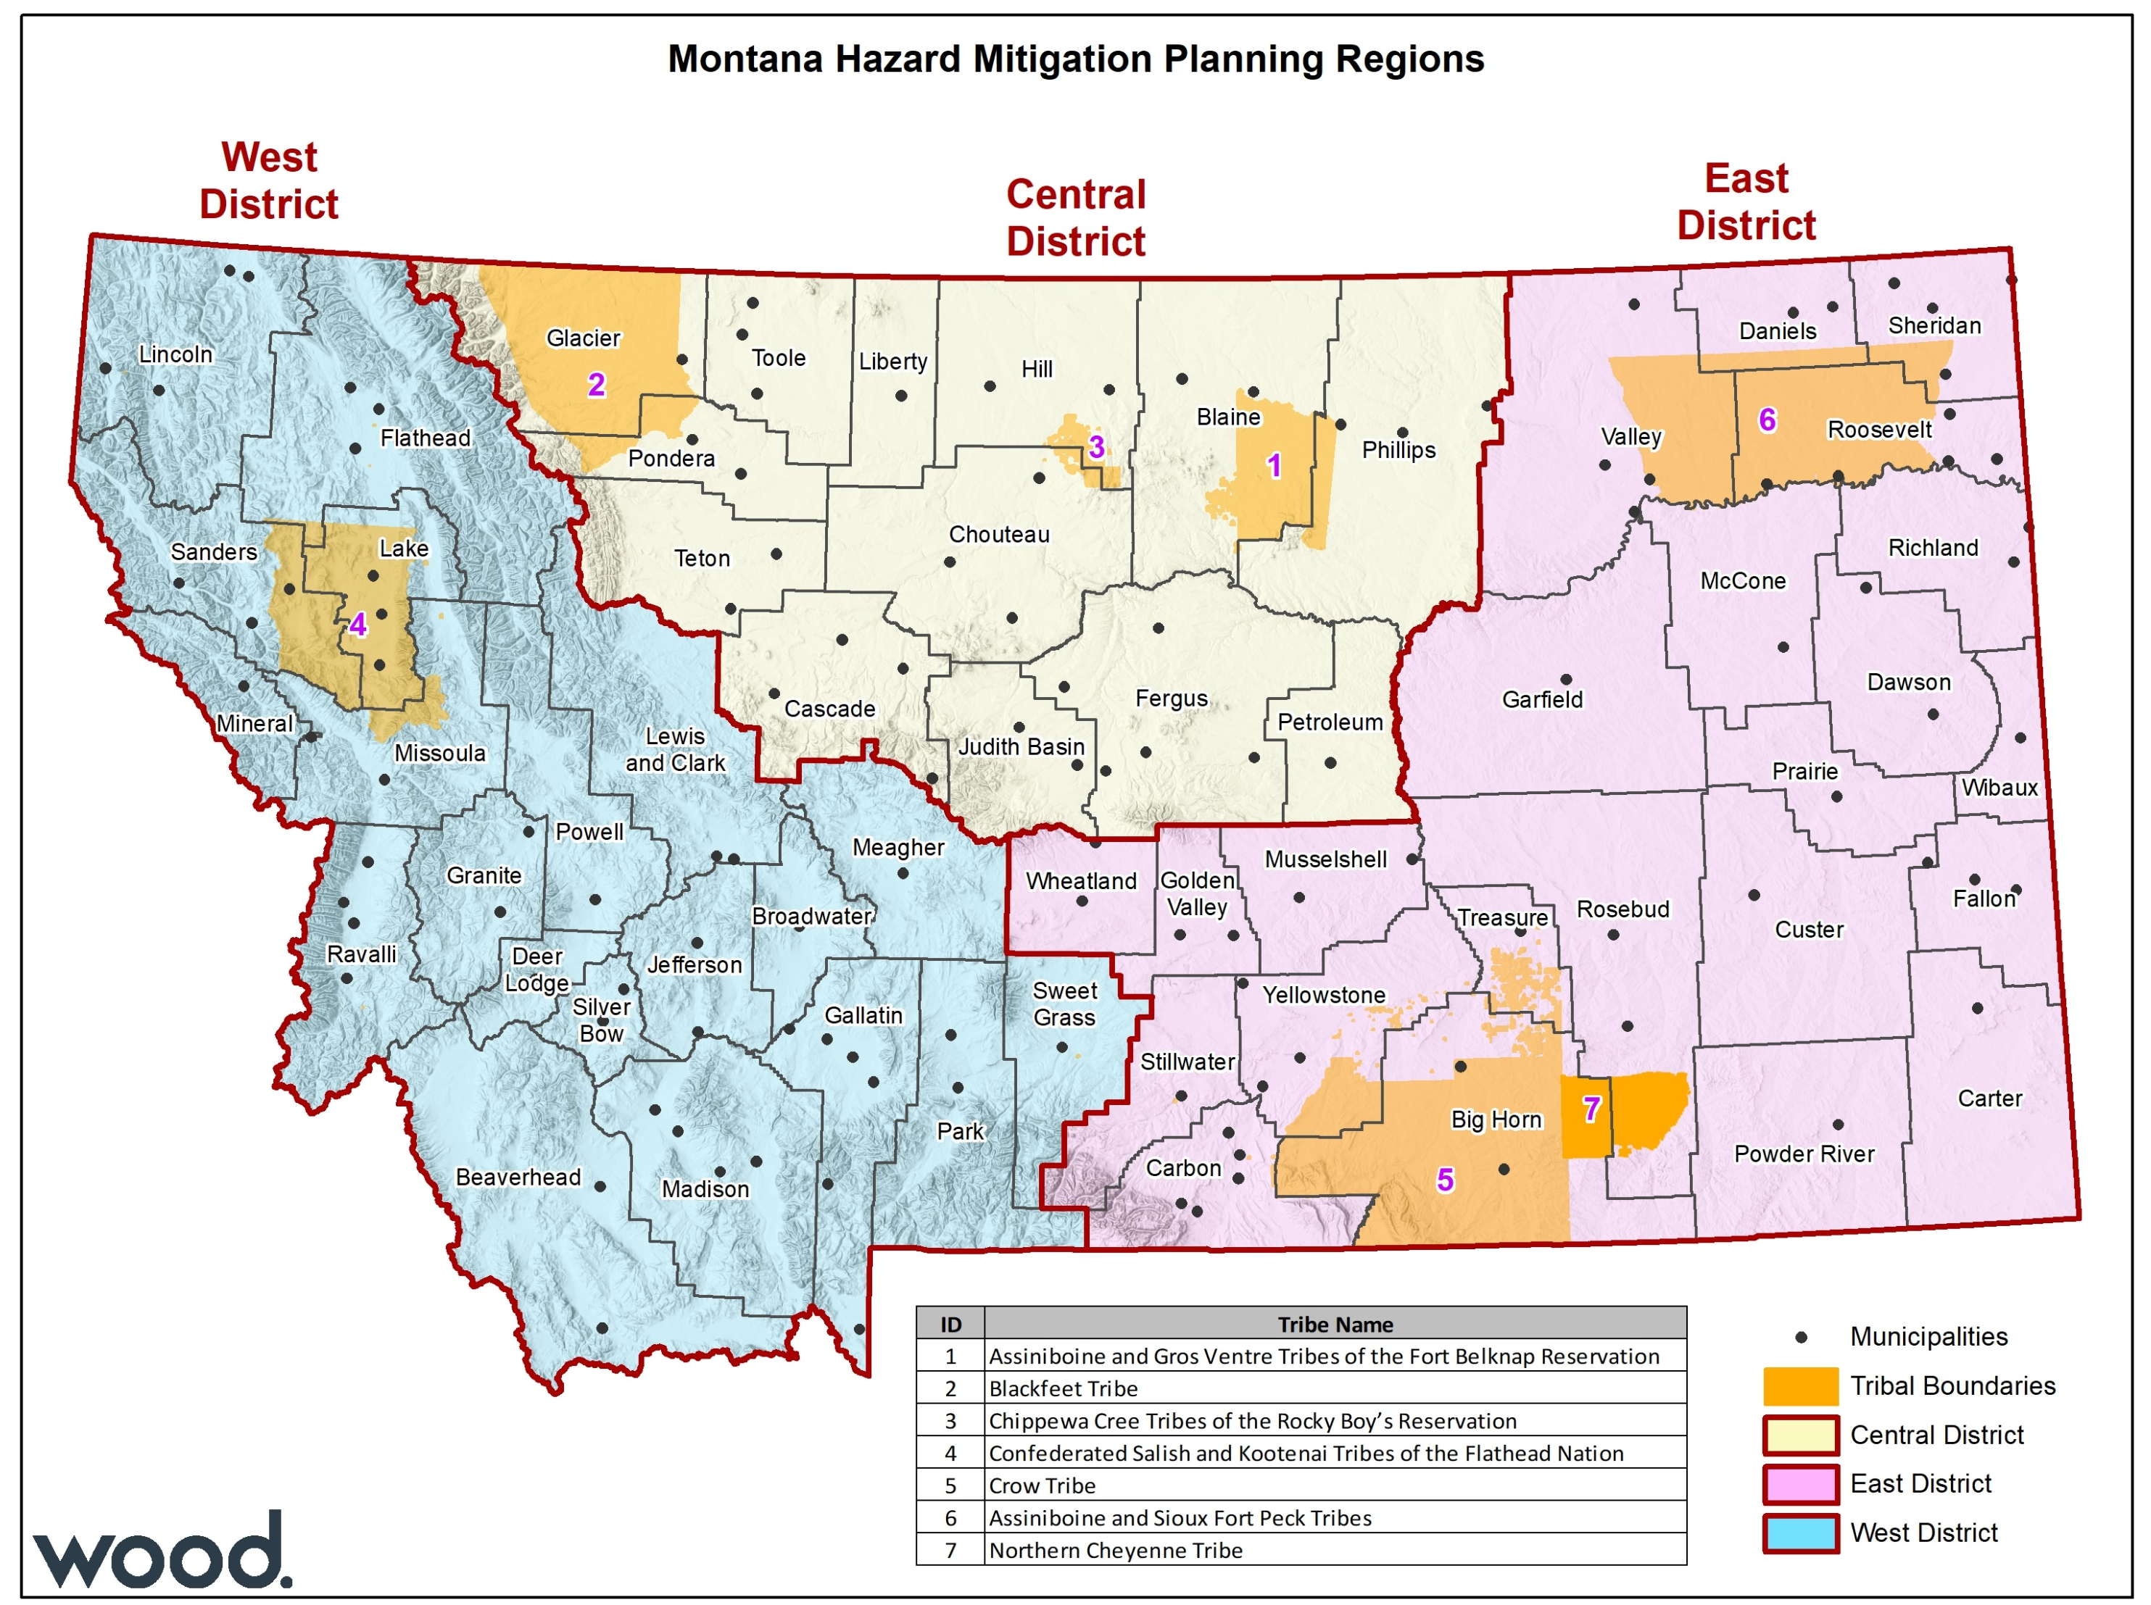
State of Montana Central Region Hazard Mitigation Plan
Meeting 2 – Risk Assessment Update
August 17, 2022, 10:00-12:00 MDT
Please type your name, title, and affiliation in the chat box

Slide 2
Agenda
Introductions
Review of the hazard mitigation planning process
Public survey results
Hazard identification and risk assessment update review and highlights
Goals review and mitigation strategy update needs
Next steps
Questions and answers

Slide 3
Meeting Logistics
Please mute your mic when not speaking.
…but please feel free to unmute when you have something to say!
You can also use the chat log to make comments, ask questions, or provide information.
This meeting is being recorded.
Slides, meeting summary, and recording will be made available.

Slide 4
Introductions

Slide 5
Introductions
Montana Disaster and Emergency Services
Sara Hartley – State Hazard Mitigation Officer
Hannah Shultz – Mitigation Coordinator
J. Lee Okeson – Central Region Supervisor
Joey Zahara – Central Region Field Officer
Ed Greiberis – Central Region Field Officer
County/Tribal Emergency Management Coordinators
Federal & State Partners
Other Stakeholders
Wood Project Team
Jeff Brislawn – Project Manger
Scott Field – Lead Planner, Central Region
Bob Vince – Project Principal, Local Support
Juliana Prosperi – Lead Planner, East Region
Amy Carr – Lead Planner, West Region
Mack Chambers – Lead GIS Analyst
Cameron Nelson – Hazard Mitigation Specialist
Chris Johnson – Hazard Mitigation Planner/GIS
Natalie Schoen – Hazard Mitigation Planner
Emily Geery – SWCA Wildfire Risk Assessment Support
Victoria Amato – SWCA Wildfire Planning Specialist
Jurisdictional representatives & stakeholders
Type your name, title, and affiliation in chat box

Slide 6
Review of the Hazard Mitigation Planning Process

Slide 7
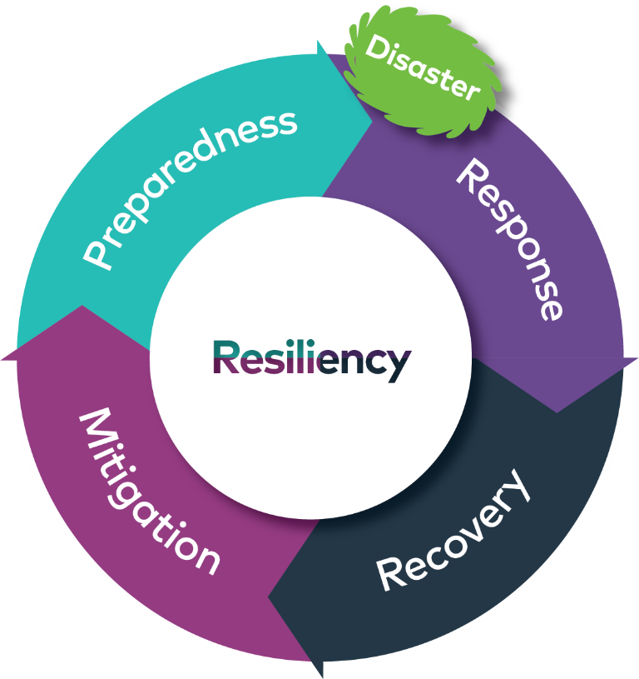
Terminology
Hazard: Act or phenomenon with potential to do harm
Vulnerability: Susceptibility to harm, damage, loss
Exposure: People, property, systems or functions that could be lost to a hazard
Risk: Combines hazard, vulnerability, exposure and probability
Mitigation: Actions taken in advance of a hazard’s impact that reduce its severity

Slide 8
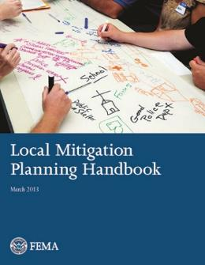
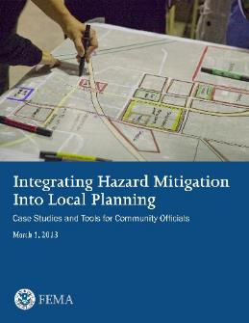
Disaster Mitigation Action of 2000
Federal Legislation
44 CFR 201.6
Requires communities to update their hazard mitigation plans every 5 years to remain eligible for federal pre- and post-disaster funding for hazard mitigation grants from FEMA
Plan ensures the counties and municipalities in the Region will remain eligible for mitigation projects when funding becomes available

Slide 9
FEMA’s Nine-Step Planning Process
Step 1 Determine the Planning Area and Resources
Step 2 Build the Planning Team
Step 3 Create an Outreach Strategy
Step 4 Review Community Capabilities
Step 5 Conduct a Risk Assessment
Step 6 Develop a Mitigation Strategy
Step 7 Keep the Plan Current
Step 8 Review and Adopt the Plan
Step 9 Create a Safe and Resilient Community

Slide 10
Progress So Far
Kickoff meeting March 31, 2022
Risk and capability assessments in process of being drafted by Wood, based on research and HMPC/stakeholder input
Plan update guides provided to participating jurisdictions
Online public survey closed August 8th: 265 responses

Slide 11
Public Survey Results

Slide 12
Public Survey Results
Please indicate the level of significance you perceive for each hazard for the community you live in.

Slide 13
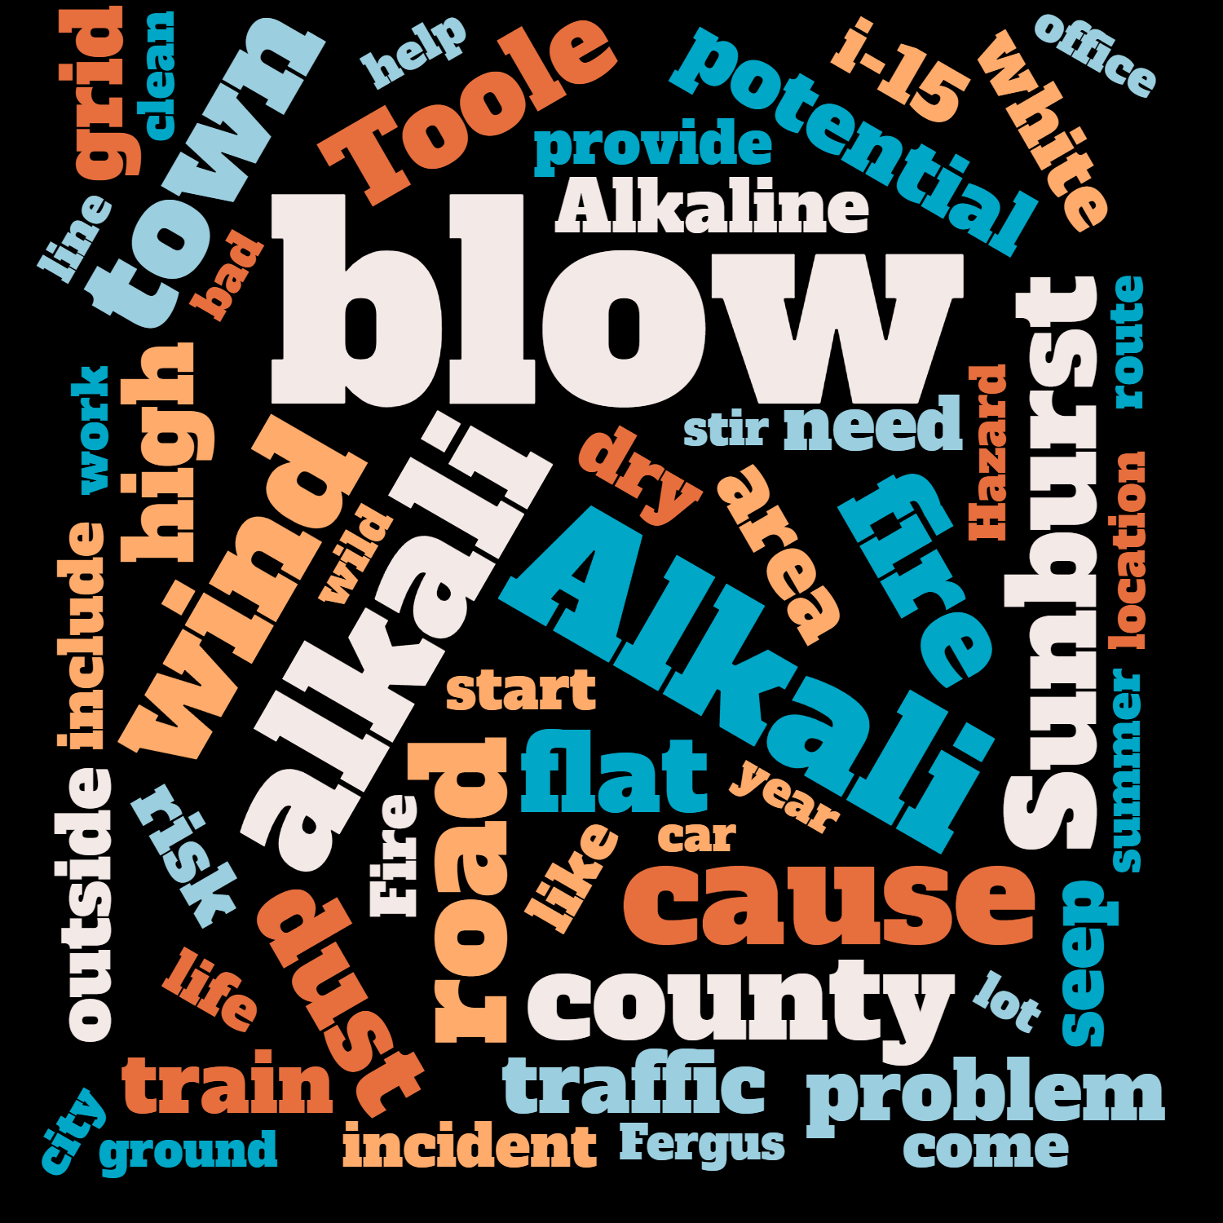
Public Survey Results
Other hazards/specific hazard issues/problem areas?

Slide 14
Public Survey Results
Please indicate the significance you perceive for the following mitigation action categories.

Slide 15
Public Survey Results
Please indicate the types of mitigation actions that you think should have the highest priority.

Slide 16
Public Survey Results
Which County or Reservation do you live in?
Where in the County do you live?

Slide 17
Review of Hazards and Vulnerability Assessment Update

Slide 18
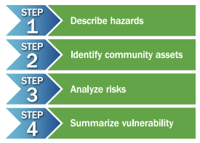
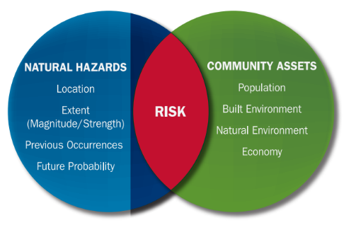
Conducting a Risk Assessment - Components
Hazard Identification
What, where, how often, how bad
Vulnerability Assessment
What will be affected?
Estimate losses by jurisdiction
Assess vulnerabilities of Critical Facilities
Includes a Mitigation Capability Assessment

Slide 19
Hazard Identification and Risk Assessment Includes
Hazard description
Past events
Location (geographical area affected)
Probability of future occurrences
Impact severity
Warning time
Related hazards
Climate change considerations
Vulnerability assessment
Population
Property
Critical facilities and infrastructure
Economy
Environment and cultural resources
Development trends
Risk summary and significance by jurisdiction

Slide 20
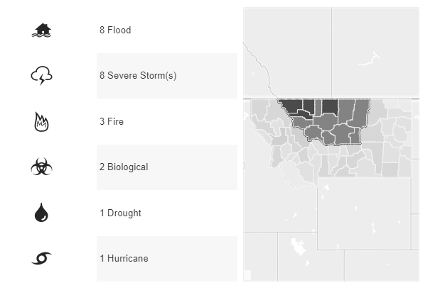
Disaster History
The Central Region has had 23 Federal Declarations since 1953

Slide 21
23 Disaster Declarations in the Central Region since 1953
Year | Declaration Title | Disaster Number | Area Impacted
1974 | SEVERE STORMS, FLOODING & LANDSLIDES | DR-417-MT | Glacier
1975 | RAINS, SHOWMELT, STORMS & FLOODING | DR-472-MT | Cascade, Fergus, Glacier, Judith Basin, Pondera, Teton, Toole
1977 | DROUGHT | EM-3050-MT | Glacier, Teton
1981 | SEVERE STORMS & FLOODING | DR-640-MT | Cascade
1986 | HEAVY RAINS, LANDSLIDES & FLOODING | DR-761-MT | Chouteau, Fergus, Glacier, Liberty, Petroleum, Phillips, Pondera, Teton, Toole
1986 | SEVERE STORMS & FLOODING | DR-777-MT | Blaine, Hill, Phillips
1996 | SEVERE STORMS, FLOODING, AND ICE JAMS | DR-1105-MT | Chouteau
1996 | SEVERE STORMS, FLOODING, ICE JAMS, SOIL SATURATION | DR-1113-MT | Blaine, Hill, Liberty, Toole, Phillips
1997 | SEVERE STORMS,ICE JAMS, SNOW MELT, FLOODING | DR-1183-MT | Judith Basin
2000 | WILDFIRES | DR-1340-MT | All counties in Central Region
2002 | SEVERE STORMS AND FLOODING | DR-1424-MT | Glacier, Liberty, Toole, Hill, Pondera
2005 | HURRICANE KATRINA EVACUATION | EM-3253-MT | Statewide
2010 | SEVERE STORMS AND FLOODING | DR-1922-MT | Hill, Chouteau, Rocky Boy’s Reservation
2011 | SEVERE STORMS AND FLOODING | DR-1996-MT | All counties in Central Region
2013 | FLOODING | DR-4127-MT | Hill, Chouteau, Blaine, Fergus, Petroleum, Rocky Boy’s Reservation, Fort Belknap
2014 | ICE JAMS AND FLOODING | DR-4172-MT | Pondera
2014 | SEVERE STORMS, STRAIGHT-LINE WINDS, AND FLOODING | DR-4198-MT | Blaine, Fort Belknap, Petroleum
2016 | SEVERE WINTER STORM AND STRAIGHT-LINE WINDS | DR-4271-MT | Liberty, Toole, Glacier, Pondera, Teton
2017 | LODGEPOLE FIRE COMPLEX | FM-5194-MT | Petroleum
2017 | STRAWBERRY FIRE | FM-5212-MT | Blackfeet Reservation, Pondera, Teton
2018 | FLOODING | DR-4388-MT | Pondera, Toole, Liberty, Hill, Blaine, Petroleum
2020 | COVID-19 | EM-3476-MT | Statewide
2020 | COVID-19 PANDEMIC | DR-4508-MT | Statewide

Slide 22
Asset Inventory Update
Parcel level analysis
Assessors’ data, parcel centroids
General property
Residential, commercial, etc.
People
Critical facilities and infrastructure
Grouped by FEMA Lifeline categories
Notes:
Limited parcel analysis for tribes, esp. Rocky Boys & Little Shell
Critical facilities analysis TBD

Slide 23
Hazard Rankings
Location/Spatial Extent
Extensive: 50-100% of planning area
Significant: 10-50% of planning area
Limited: Less than 10% of planning area
Potential Severity
Catastrophic: Multiple deaths, shutdown of facilities for 30 days or more, >50% of property is severely damaged
Critical: Multiple severe injuries, shutdown of facilities for at least 2 weeks, >25% of property is severely damaged
Moderate: Some injuries, shutdown of critical facilities for more than one week, >10% of property is severely damaged
Negligible: Minor injuries, minimal quality-of-life impact, interruption of facilities and services for 24 hours or less, less than 10% of property is severely damaged.
Frequency of Occurrence
Highly Likely: Near 100% probability each year.
Likely: Between 10 and 100% probability per year or at least one chance in ten years.
Occasional: Between 1 and 10% probability per year or at least one chance in next 100 years.
Unlikely: Less than 1% probability in next 100 years.
Significance (combination of Location/Severity/Frequency)
High: widespread potential impact
Medium: moderate potential impact
Low: minimal potential impact

Slide 24
Join at slido.com #HMPC2
ⓘ Start presenting to display the joining instructions on this slide.

Slide 25
What jurisdiction do you represent?
ⓘ Start presenting to display the poll results on this slide.

Slide 26
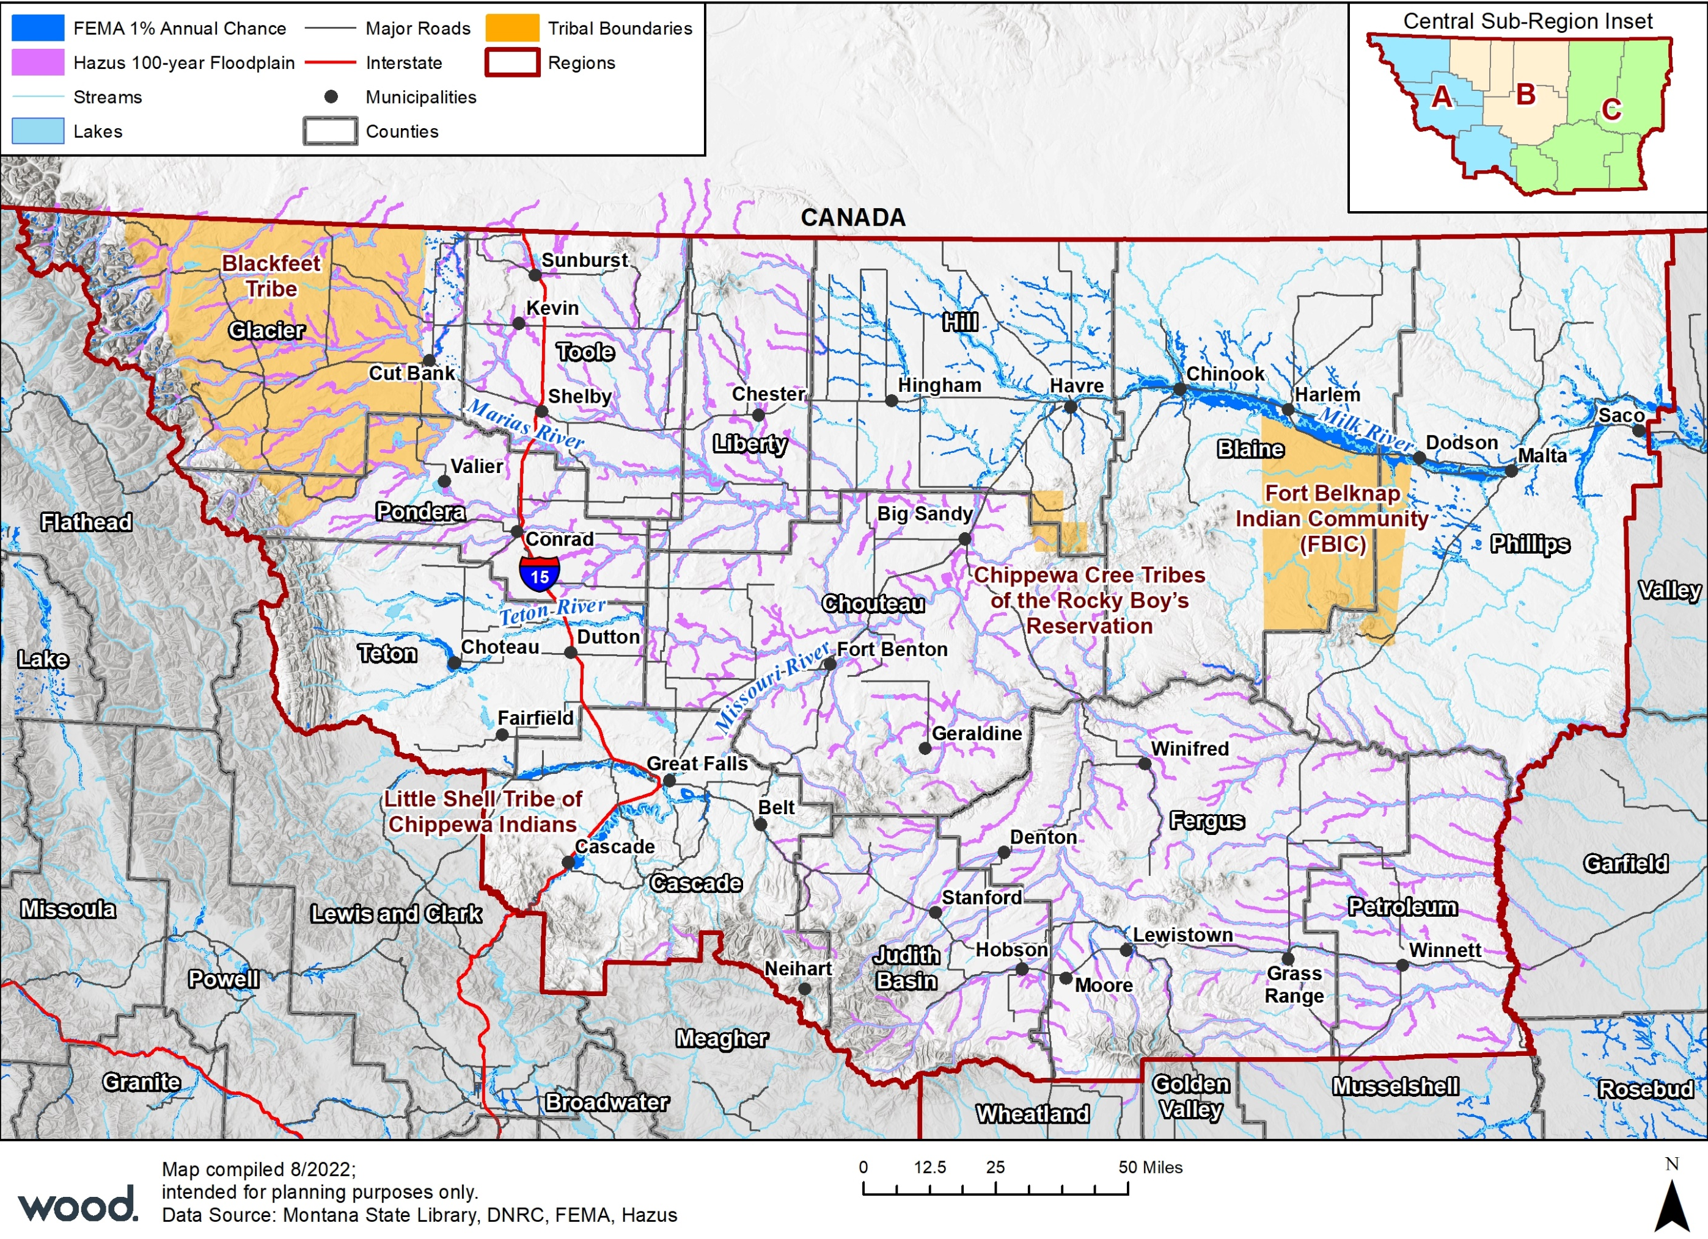
Flooding – Montana Central Region Flood Hazards
The Missouri River, along with its tributaries are Central Montana’s primary flood hazards. Among the major tributaries are the Marias, Milk, Sun and Teton Rivers.
Montana’s Central Region averages 7 flooding events per year based on NCEI data.
Flood Sources
County | Flood Source
Blaine | NFHL
Cascade | NFHL
Chouteau | Hazus
Fergus | NFHL (partial), Hazus
Glacier | DNRC (partial), Hazus
Hill | DNRC
Judith Basin | Hazus
Liberty | Hazus
Petroleum | Hazus
Phillips | DNRC
Pondera | Hazus
Teton | DNRC
Toole | Hazus
NFHL counties: 3*
Digitized paper FIRM counties: 4*
Hazus-based approximate flood hazard areas counties: 8*
*some counties are partial and Hazus was used to supplement to get complete coverage.

Slide 27
Flooding – Past Occurrences
NCEI Reported Flood Events Montana Central Region (1996-2022)
County | # of Events | Property Damage | Crop Damage
Blaine | 16 | $30,000 | -
Cascade | 21 | $330,000 | -
Chouteau | 8 | $150,000 | -
Fergus | 12 | $125,000 | -
Glacier | 11 | - | -
Hill | 6 | $233,000 | -
Judith Basin | 6 | $50,000 | -
Liberty | 1 | - | -
Petroleum | 21 | $515,00 | -
Phillips | 48 | $16,000 | $10,000
Pondera | 11 | - | -
Teton | 9 | $250,000 | -
Toole | 5 | $10,000 | -
Average (per year) | 13 | $45,538 | $385
Total | 183 | $1,184,000 | $10,000
Location: Flood risk is present within all Central Montana's counties along the Missouri River watershed and tributaries
Extent: Can be small (less than 10 acres) with minimal damage, or very large and destructive
Probability: Likely throughout the planning area
NFIP:
According to the National Center of Environmental Information Montana's Central Region has seen 183 flood events between 1996 – 2022
Resulting in $1,184,000 in Property Damages and $10,000 crop damage that has been reported.
Phillips County has the highest number of recorded events with 49 total
Montana's Central region has also seen 26 ice jam flood events within the study area.
11 of which have occurred in Chouteau County.
The Central Region can expect an average of 13 flood events per year that will cause on average $45,538 in property damage and $385 in crop damages.
Source: NCEI Storm Events Database

Slide 28
Flooding – National Flood Insurance Program Policy Data
County | Date Joined | Effective Firm Date | Dollars Paid (Historical) | Flood Claims | Current Policies | Coverage ($) | Repetitive Loss Properties | Repetitive Loss Properties ($ Paid)
Blaine | 2/7/1978 | 9/20/2006 | $71,266 | 53 | 20 | $2,745,200 | 1 | $9,947.34
Cascade | 4/15/1980 | 3/19/2013 | $860,925 | 260 | 343 | $78,188,200 | 19 | $170,515.43
Chouteau | - | - | - | - | 5 | $1,470,000 | - | -
Fergus | 4/18/1978 | 7/22/2010 | $243,625 | 26 | 31 | $8,808,000 | 5 | $135,777.54
Glacier | 12/22/1977 | 1/1/1990 | $32,243 | 8 | 5 | $925,400 | - | -
Hill | 2/21/1978 | 6/3/1988 | $55,508 | 17 | 13 | $3,031,300 | 2 | $23,227.41
Judith Basin | - | - | - | - | - | - | - | -
Liberty | - | 8/2/1997 | $7,075 | 4 | 7 | $751,000 | - | -
Petroleum | - | 11/15/2019 | - | - | - | - | - | -
Phillips | 2/7/1978 | 5/19/1987 | $173,304 | 50 | 13 | $1,182,900 | 5 | $27,673.46
Pondera | - | - | - | - | 6 | $4,430,900 | - | -
Teton | 11/22/1977 | 7/18/1983 | $30,662.44 | 5 | 21 |  | - | -
Toole | - | 5/21/2009 | $415.66 | 1 | - | - | - | -
Total |  |  | $4,758,879 | 424 | 464 | $143,511,600 | 32 | $367,141,18
Source: FEMA Pivot NFIP Data as of August 10th, 2022; FEMA Community Status Book Report
Notes:
Cascade County has 260 NFIP Claims & 343 current policies. Also $78,188,200 in NFIP Coverage which is highest.

Slide 29
Flooding – Parcels at Risk to 1% Annual Flood Event
County | Improved Parcels | Improved Value | Content Value | Total Value | Estimated Loss | Population
Blaine | 316 | $27,223,932 | $22,301,097 | $49,525,029 | $12,381,257 | 355
Cascade | 1,421 | $287,997,529 | $157,578,850 | $445,576,379 | $111,394,095 | 2,960
Chouteau | 258 | $33,617,442 | $20,634,719 | $54,252,161 | $13,563,040 | 492
Fergus | 594 | $72,319,943 | $41,169,577 | $113,489,520 | $28,372,380 | 1,112
Glacier* | 256 | $28,213,293 | $27,827,976 | $56,041,269 | $14,010,317 | 578
Hill | 81 | $14,098,176 | $11,893,088 | $25,991,264 | $6,497,816 | 121
Judith Basin | 32 | $3,747,710 | $2,989,425 | $6,737,135 | $1,684,284 | 26
Liberty | 149 | $13,417,517 | $8,159,564 | $21,577,081 | $5,394,270 | 347
Petroleum | 37 | $4,671,830 | $4,305,745 | $8,977,575 | $2,244,394 | 22
Phillips | 270 | $26,455,836 | $19,845,968 | $46,301,804 | $11,575,451 | 305
Pondera | 75 | $10,442,869 | $7,594,580 | $18,037,449 | $4,509,362 | 132
Teton | 221 | $29,908,381 | $19,066,372 | $48,974,753 | $12,243,688 | 422
Toole | 245 | $24,458,143 | $16,849,637 | $41,307,780 | $10,326,945 | 513
Total | 3,955 | $576,572,601 | $360,216,595 | $936,789,196 | $234,197,299 | 7,385
Cascade County has the highest amount of Estimated Loss Value with $111M
Fergus County is a distant second in loss values with $28M
Blaine, Chouteau, Glacier, Phillips, Teton and Toole all have potential for more than $10M in losses
Overall Montana’s Central Region has $937M in total value and a combined estimated loss of $234M for 1% annual chance flooding.
There are 3,955 parcels located in the floodplain and 7,385 people at risk in Montana’s Central Region
* Majority of risk is on Blackfeet Tribe Reservation; minor risk to other tribes based on available data

Slide 30
Flooding Risk Summary
Jurisdiction | Geographic Extent | Probability of Future Occurrence | Potential Magnitude/ Severity | Overall Significance
Central Region | Limited | Likely | Limited | Medium
Blackfeet Tribe | Limited | Likely | Catastrophic | High
Blaine County | Limited | Likely | Limited | Medium
Cascade County | Limited | Likely | Catastrophic | High
Chouteau County | Limited | Likely | Limited | Medium
Fergus County | Limited | Likely | Catastrophic | High
Fort Belknap | Limited | Likely | Limited | Low
Glacier County | Limited | Likely | Limited | Medium
Hill County | Limited | Likely | Limited | Medium
Judith Basin County | Limited | Likely | Limited | Medium
Liberty County | Limited | Likely | Limited | Medium
Petroleum County | Limited | Likely | Limited | Low
Phillips County | Limited | Highly Likely | Limited | Medium
Pondera County | Limited | Likely | Limited | Low
Rocky Boys | Limited | Likely | Limited | Low
Teton County | Limited | Likely | Limited | Medium
Toole County | Limited | Likely | Limited | Medium
What do you think the significance of flooding is for your jurisdiction?
ⓘ Start presenting to display the poll results on this slide.

Slide 31
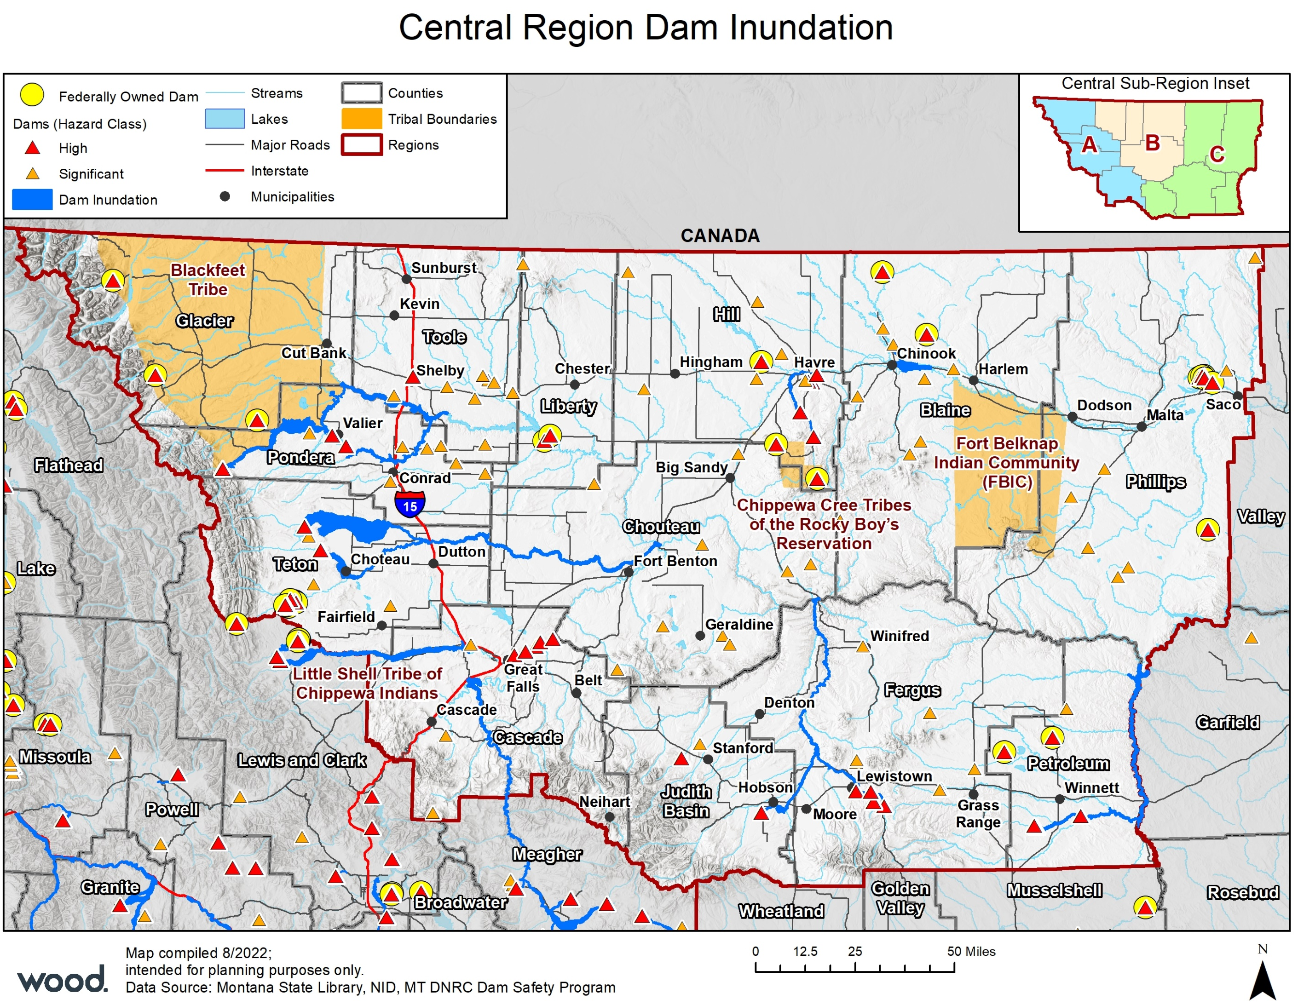
Dam Incidents
Can be a complete failure, or an unexpected release causing rapid downstream flooding
Dams classified as:
High Hazard – failure would likely cause loss of life downstream
Significant Hazard – failure could result in significant property damage
Low Hazard – failure would result only in minimal property damage
According to NID, there are 962 dams throughout the Region
55 High Hazard
65 Significant Hazard
100% of the high hazard dams have EAPs on file
Notes:
No inundation mapping for federal dams

Slide 32
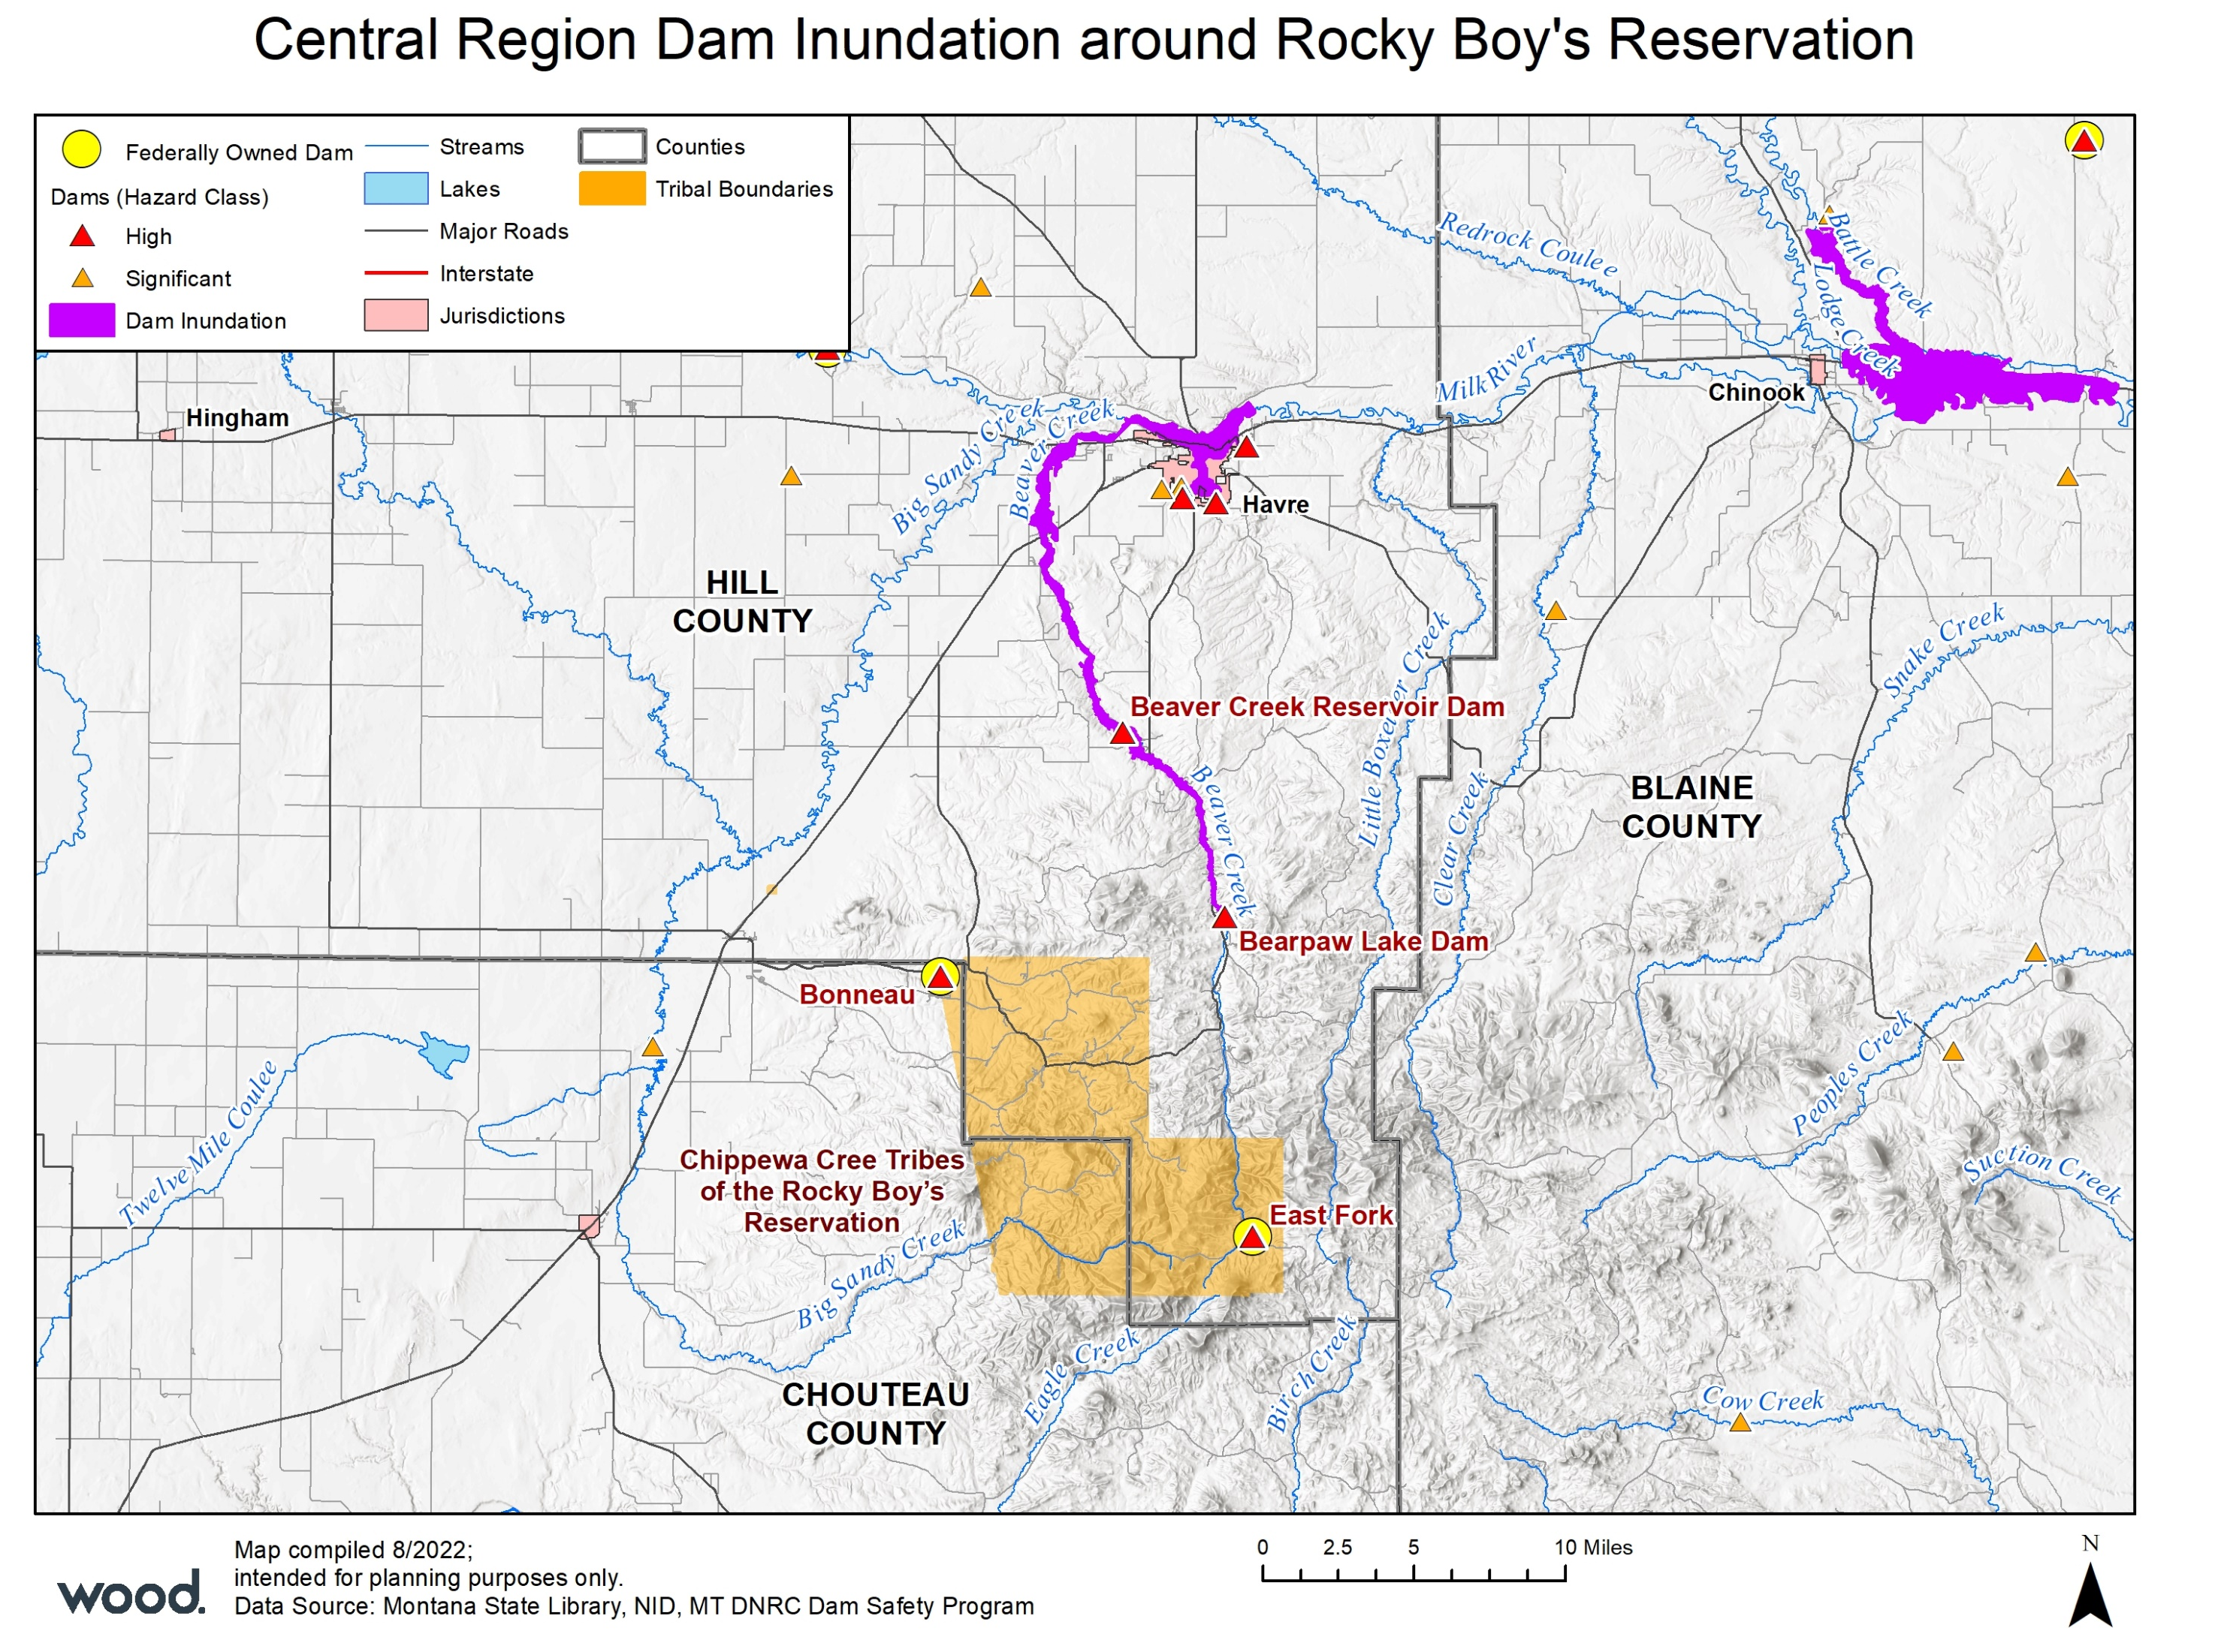
Dam Incidents
Notes:
No inundation mapping for federal dams

Slide 33
Dam Incidents
2 past occurrences in the Region, both impacting the Blackfeet Indian Reservation, the Swift Dam and Two Medicine Dams in June of 1964
Led to 30 deaths downstream, 265 homes lost, 20,000 acres of hay land, and an estimated $626 million (2022 $) in damage
Central Region Parcels at Risk to Overall Dam Inundation by County
County | Improved Parcels | Improved Value | Content Value | Total Value | Population
Blaine | 57 | $5,213,584 | $4,313,242 | $42,688,846 | 80
Cascade | 317 | $44,286,131 | $28,098,298 | $201,488,858 | 552
Chouteau | 94 | $6,786,247 | $4,865,289 | $208,750,075 | 175
Fergus | 1,037 | $134,742,186 | $72,047,498 | $846,650,132 | 2,117
Glacier | 3 | $312,030 | $312,030 | $3,945,200 | 0
Hill | 1,889 | $300,713,007 | $168,373,317 | $1,874,880,516 | 4,498
Judith Basin | 4 | $914,070 | $765,110 | $9,159,880 | 4
Liberty | - | - | - | - | -
Petroleum | 11 | $2,862,110 | $2,776,045 | $12,550,505 | 7
Phillips | - | - | - | - | -
Pondera | 41 | $4,585,162 | $3,763,531 | $63,370,052 | 47
Teton | 1,019 | $133,050,780 | $80,497,647 | $861,563,942 | 2,121
Toole | 464 | $60,990,324 | $41,462,571 | $269,022,489 | 994
 | 4,936 | $694,455,631 | $407,274,577 | $4,394,070,494 | 10,594

Slide 34
Dam Incident Risk Summary
Jurisdiction | Geographic Extent | Probability of Future Occurrence | Potential Magnitude/ Severity | Overall Significance
Blackfeet Nation | Negligible | Occasional | Critical | Medium
Blaine | Limited | Unlikely | Limited | Medium
Cascade | Limited | Unlikely | Limited | Medium
Rocky Boy | Negligible | Unlikely | Negligible | Medium
Chouteau | Significant | Unlikely | Limited | Medium
Fergus | Limited | Unlikely | Critical | Medium
Fort Belknap | Negligible | Unlikely | Negligible | Medium
Glacier | Negligible | Unlikely | Negligible | Medium
Hill | Limited | Unlikely | Critical | Medium
Judith Basin | Limited | Unlikely | Limited | Medium
Liberty | Negligible | Unlikely | Limited | Medium
Petroleum | Limited | Unlikely | Limited | Medium
Phillips | Negligible | Unlikely | Limited | Medium
Pondera | Significant | Unlikely | Limited | Medium
Teton | Significant | Unlikely | Critical | Medium
Toole | Limited | Unlikely | Limited | Medium
What do you think the significance of dam failure is for your jurisdiction?

Slide 35
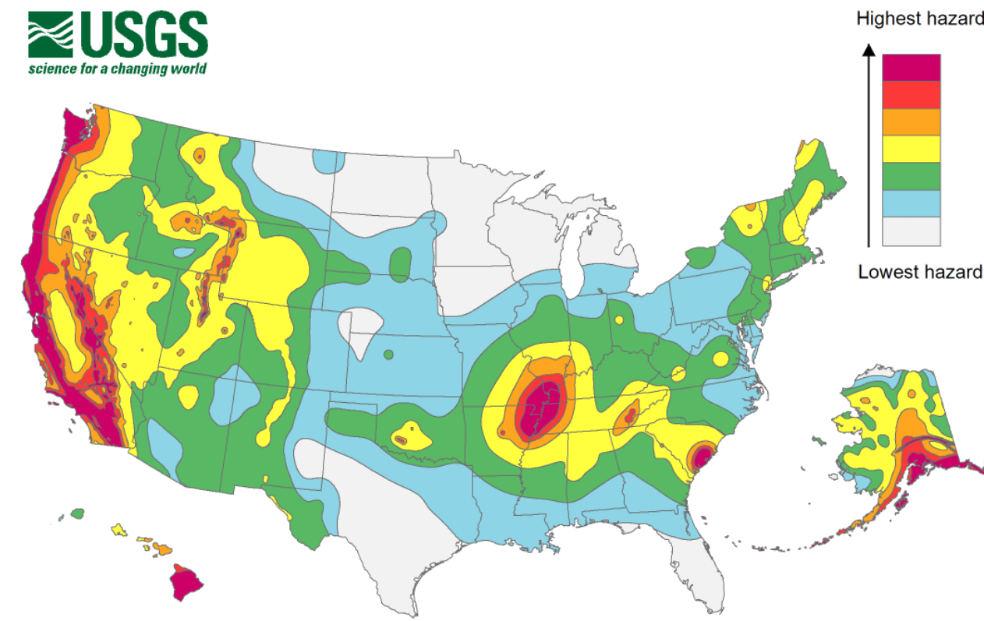
Earthquake
Long Term Probabilistic Seismic Hazard Map 2018
Montana is one of the most seismically active states in the U.S according to USGS
Much of this activity has been concentrated in the Intermountain Seismic Belt in the western third of the state
Largest known event in the state was the M7.2 Hebgen Lake event in 1959
Likelihood of occurrence is occasional (>1% probability in a given year) but impacts could be significant

Slide 36
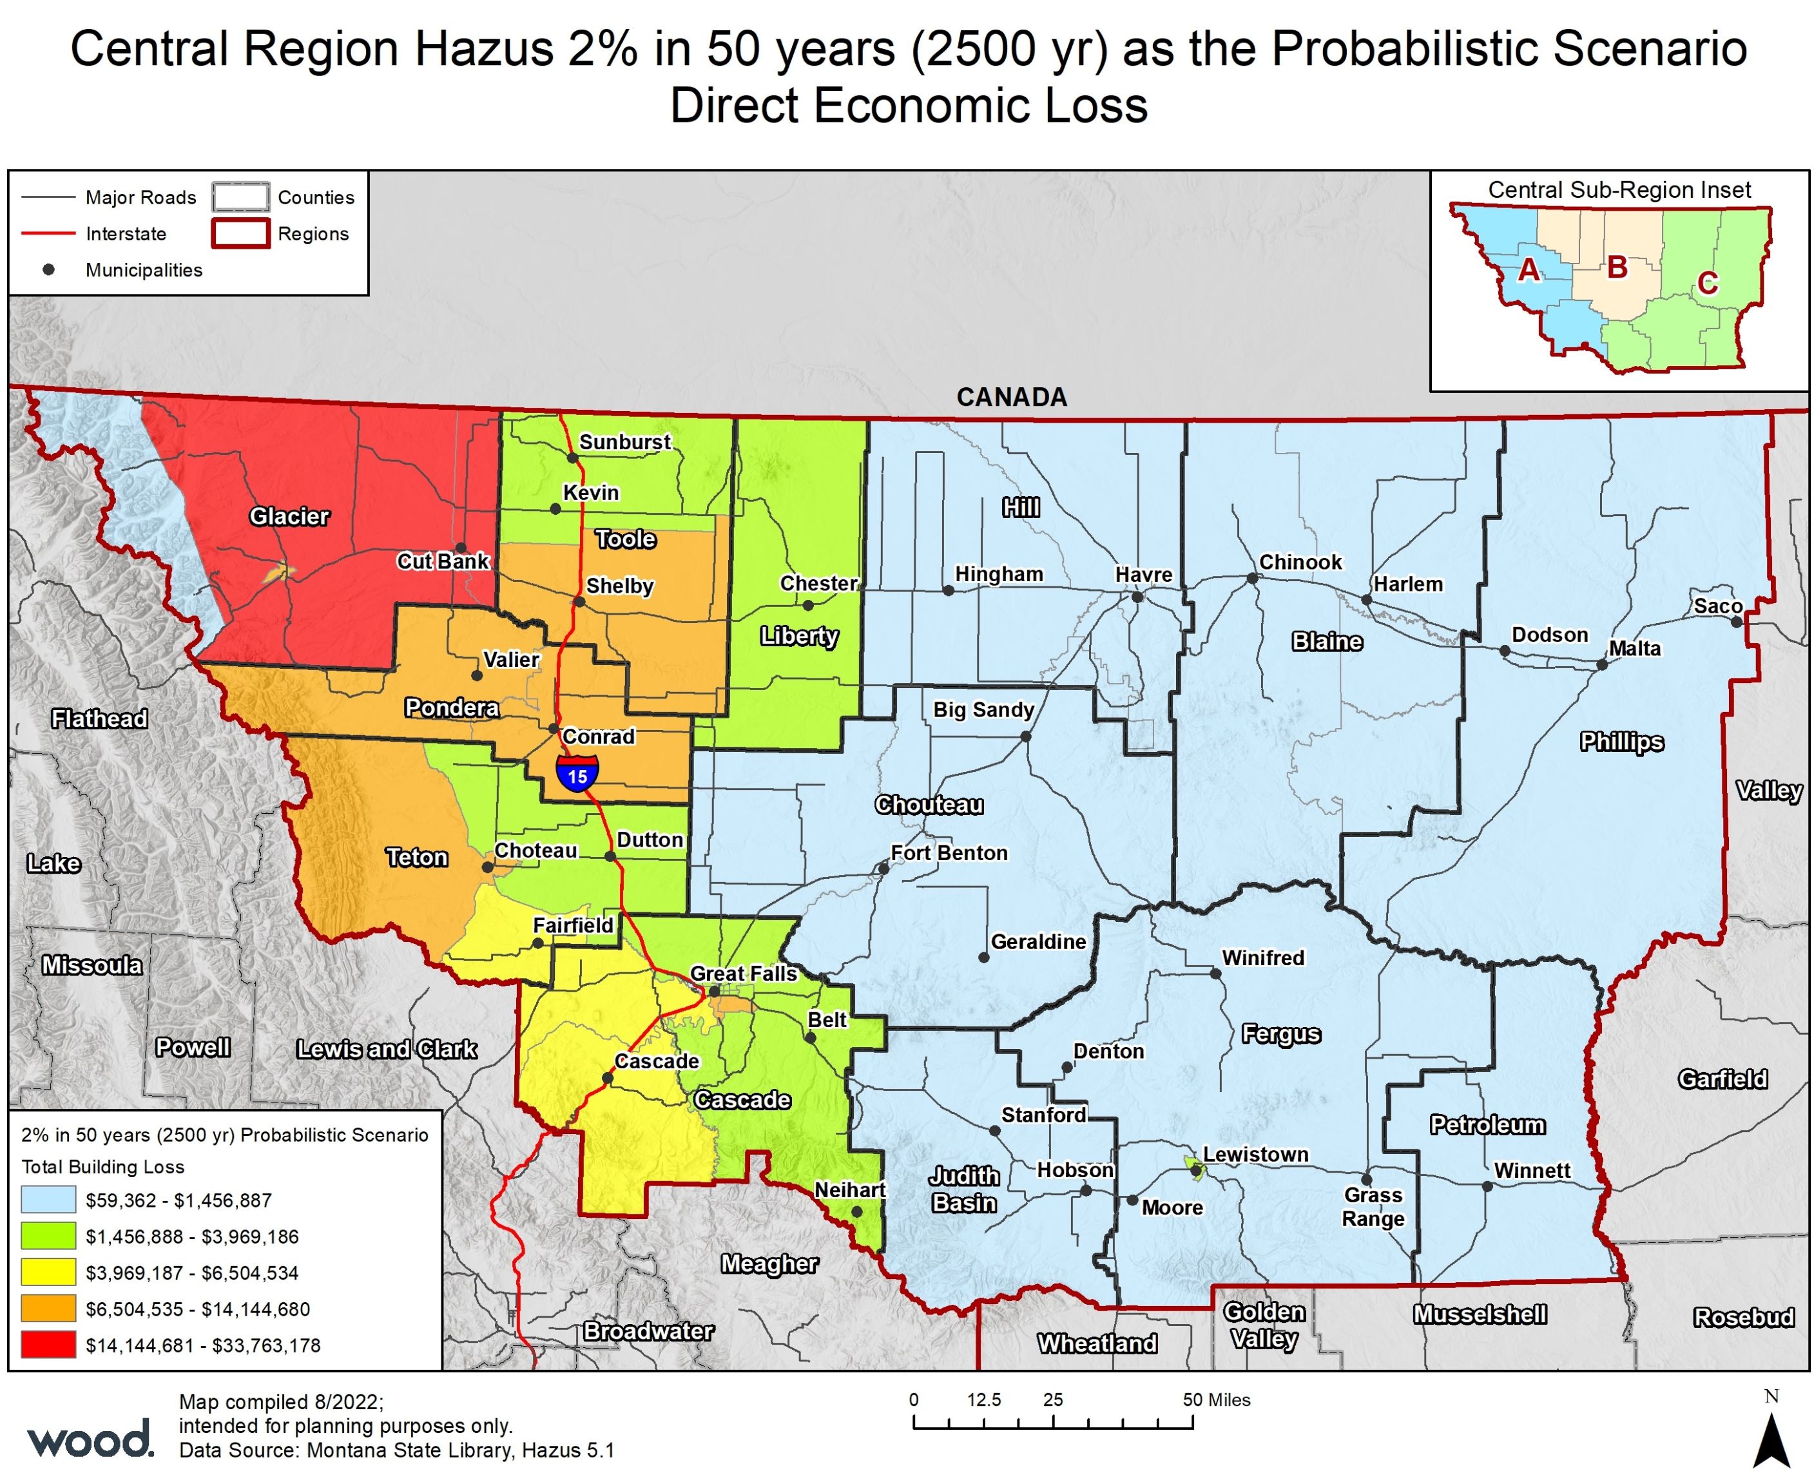
Earthquake
Hazus 2,500-year M5.0 Probabilistic Scenario conducted
Model uses USGS probabilistic seismic hazard maps to model ground shaking with a 2 percent probability of being exceeded in 50 years
Region Totals:
56 injuries, 2 fatalities
$1.42 billion in total economic losses
8,502 buildings at least slightly damaged, 323 of them extensively damaged and 18 destroyed
81 displaced households
52,000 tons of debris generated
Several related/cascading hazards: Landslide, Rockfall, Liquefaction, Fire

Slide 37
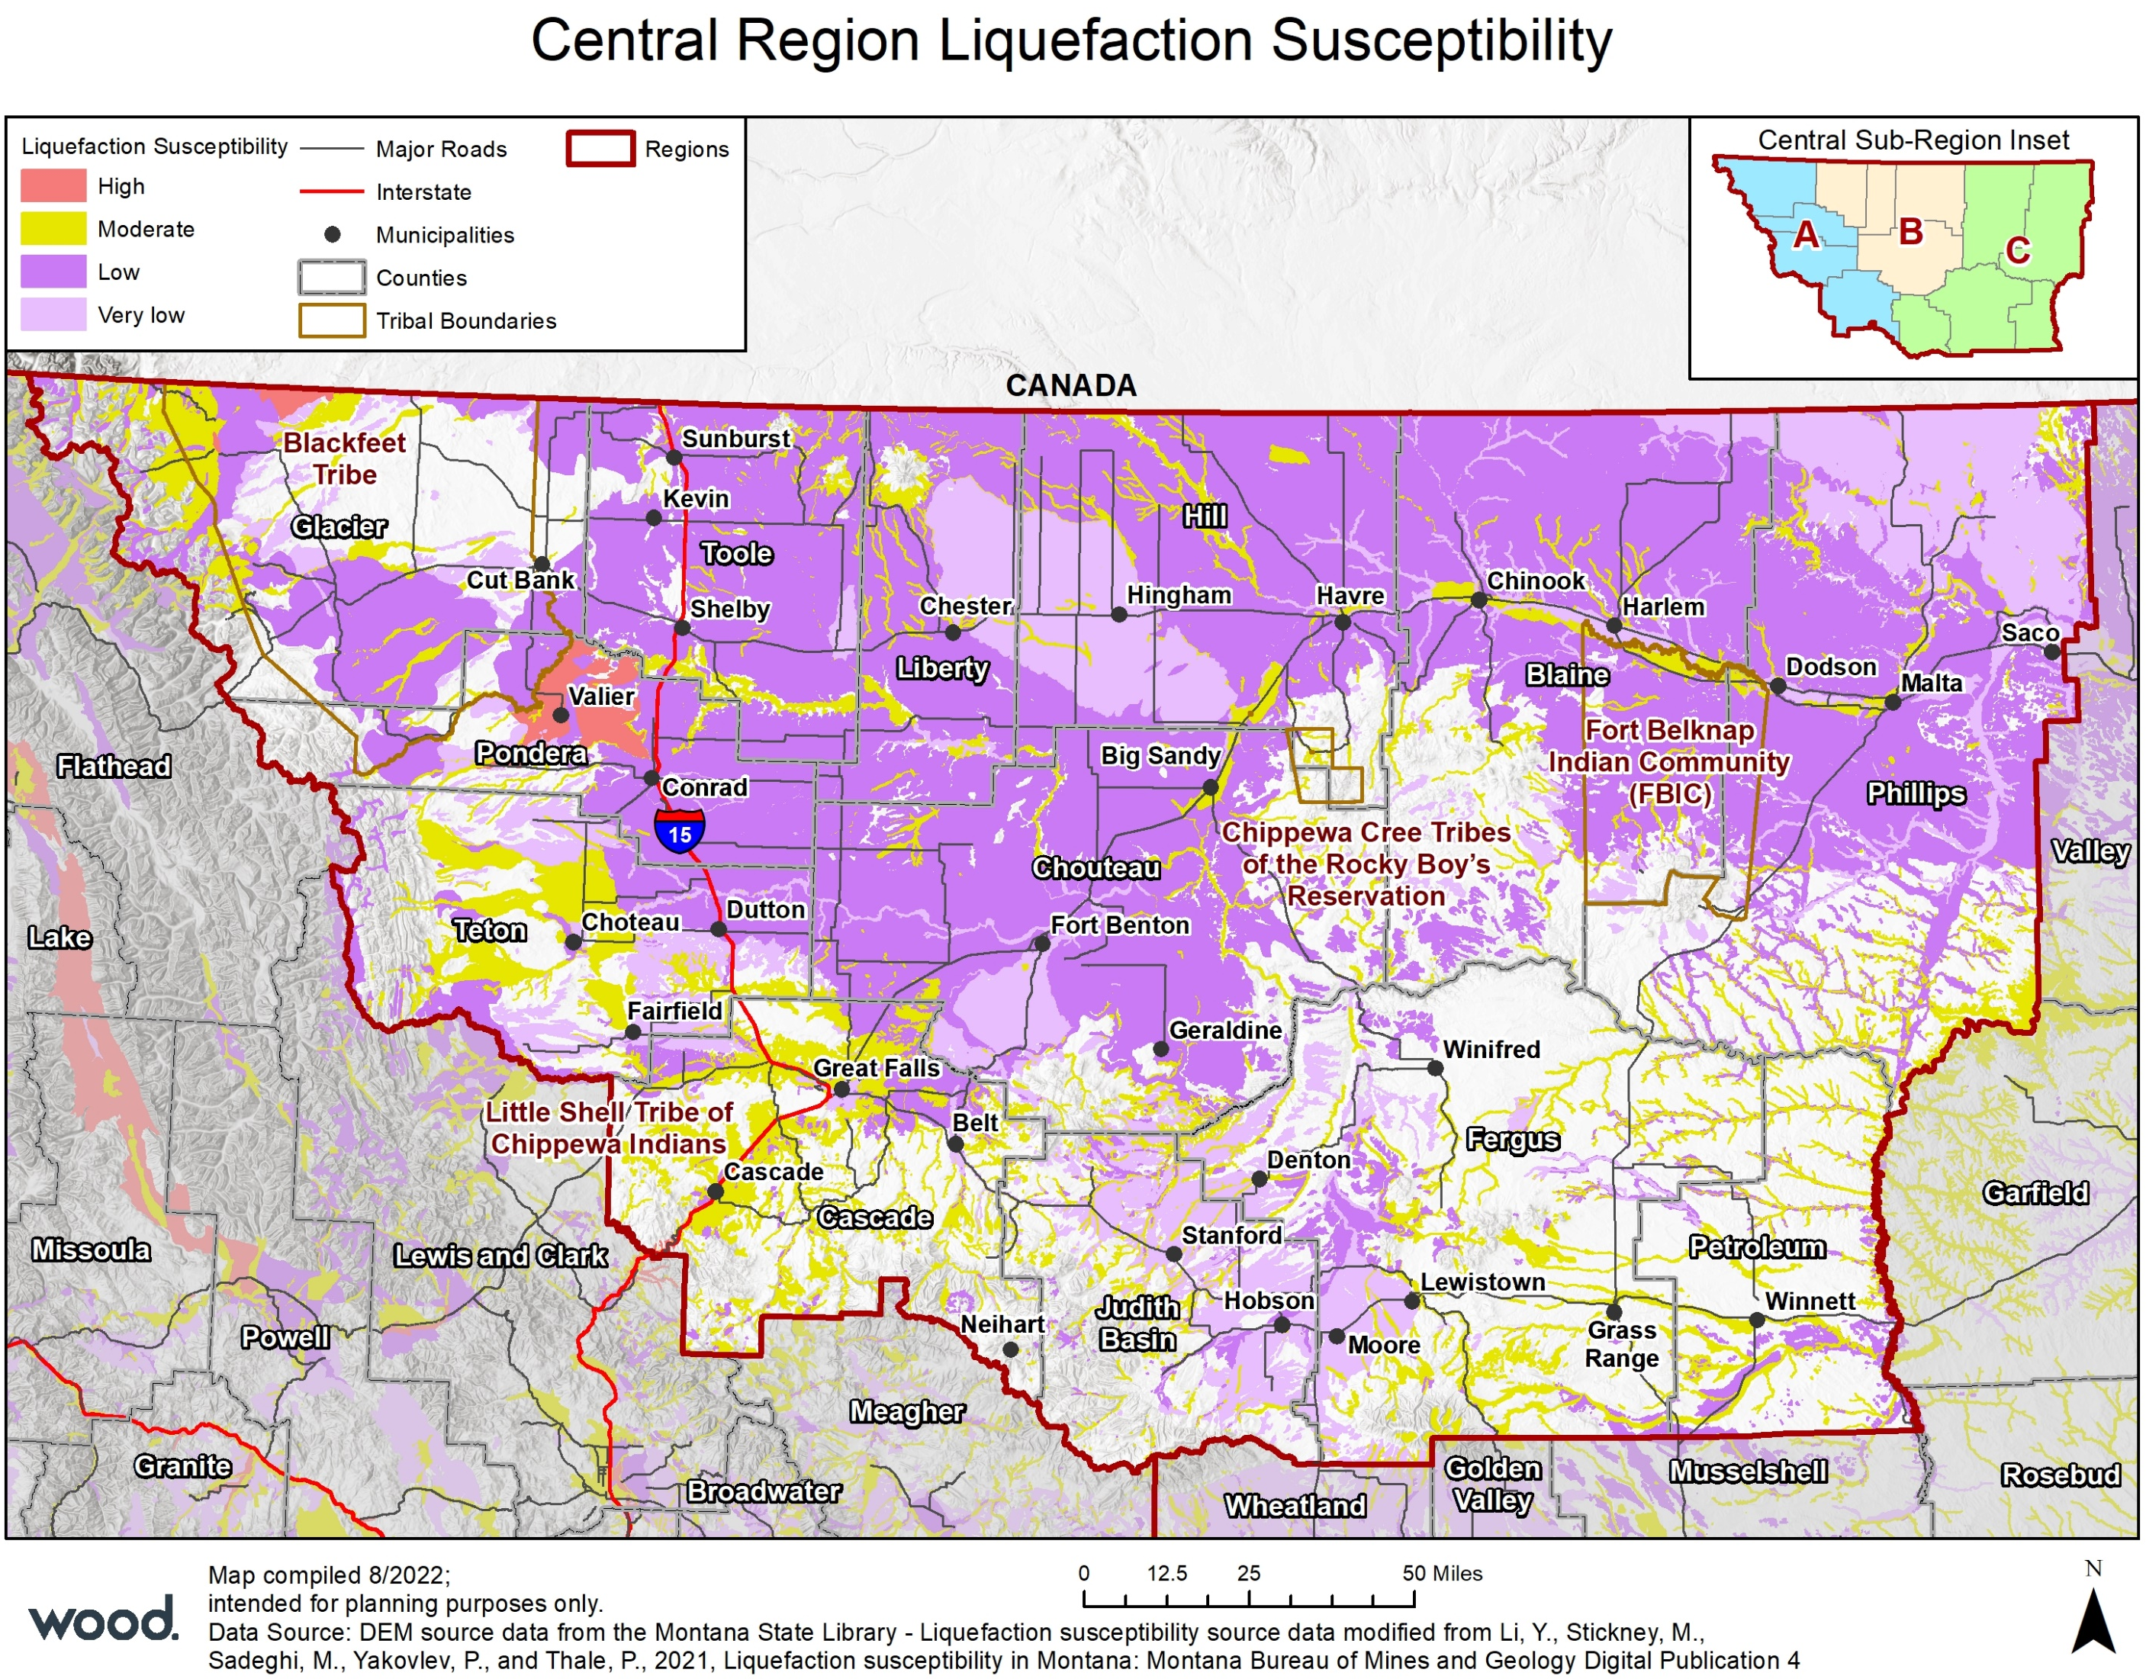
Earthquake

Slide 38
Earthquake Risk Summary
Jurisdiction | Geographic Extent | Probability of Future Occurrence | Potential Magnitude/ Severity | Overall Significance
Blackfeet Nation | Significant | Occasional | Limited | Low
Blaine | Significant | Unlikely | Negligible | Low
Cascade | Significant | Occasional | Limited | Low
Rocky Boy | Significant | Unlikely | Negligible | Low
Chouteau | Significant | Unlikely | Negligible | Low
Fergus | Significant | Unlikely | Negligible | Low
Fort Belknap | Significant | Unlikely | Negligible | Low
Glacier | Significant | Occasional | Limited | Low
Hill | Significant | Unlikely | Negligible | Low
Judith Basin | Significant | Occasional | Negligible | Low
Liberty | Significant | Unlikely | Negligible | Low
Petroleum | Significant | Unlikely | Negligible | Low
Phillips | Significant | Unlikely | Negligible | Low
Pondera | Significant | Occasional | Limited | Low
Teton | Significant | Occasional | Limited | Low
Toole | Significant | Unlikely | Limited | Low
What do you think the significance of earthquake is for your jurisdiction?

Slide 39
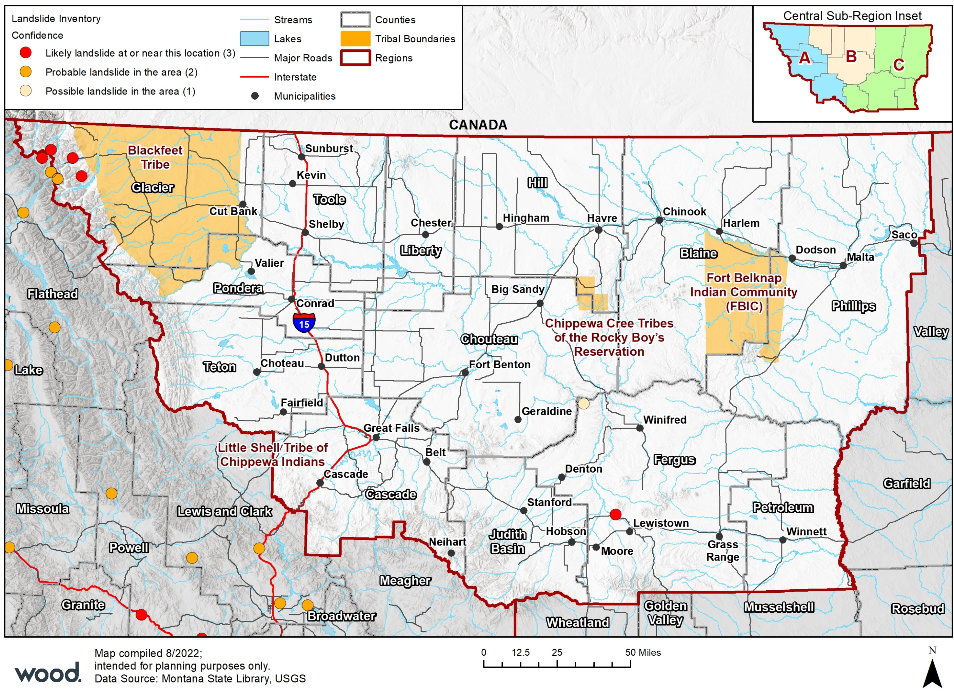
Landslide/Rockfall/Debris Flow
Location: Glacier and Fergus Counties have the highest risk of Landslide. 6 are located in Glacier County, 4 of which are Red/Likely areas and run adjacent to the Blackfeet Tribe Reservation. One likely area is within Fergus County near Lewistown.
Extent: Can be massive or disturb only a few cubic feet
Probability: Highly Likely in Glacier and Likely in Fergus county and low in the other jurisdictions of the Central Region
Impacts:
Structural Damage
Road Closure
Power and Communication Failure
Damage to Rivers and Streams, reduced water quality
Erosion and Deposition
Flooding
Notes:
DATA DEFICIENCY
Includes rockfall, debris flow as well as slumps
Spring is typical landslide/rockfall season

Slide 40
Landslide Risk Summary
Jurisdiction | Geographic Extent | Probability of Future Occurrence | Potential Magnitude/ Severity | Overall Significance
Central Region | Limited | Unlikely | Negligible | Low
Blackfeet Tribe | Limited | Unlikely | Negligible | Low
Blaine County | Limited | Unlikely | Negligible | Low
Cascade County | Limited | Unlikely | Negligible | Low
Chouteau County | Limited | Unlikely | Negligible | Low
Fergus County | Limited | Likely | Limited | Low
Fort Belknap | Limited | Unlikely | Negligible | Low
Glacier County | Limited | Likely | Limited | Medium
Hill County | Limited | Unlikely | Negligible | Low
Judith Basin County | Limited | Unlikely | Negligible | Low
Liberty County | Limited | Unlikely | Negligible | Low
Petroleum County | Limited | Unlikely | Negligible | Low
Phillips County | Limited | Unlikely | Negligible | Low
Pondera County | Limited | Unlikely | Negligible | Low
Rocky Boy | Limited | Unlikely | Negligible | Low
Teton County | Limited | Unlikely | Negligible | Low
Toole County | Limited | Unlikely | Negligible | Low
What do you think the significance of landslide is for your jurisdiction?
ⓘ Start presenting to display the poll results on this slide.

Slide 41
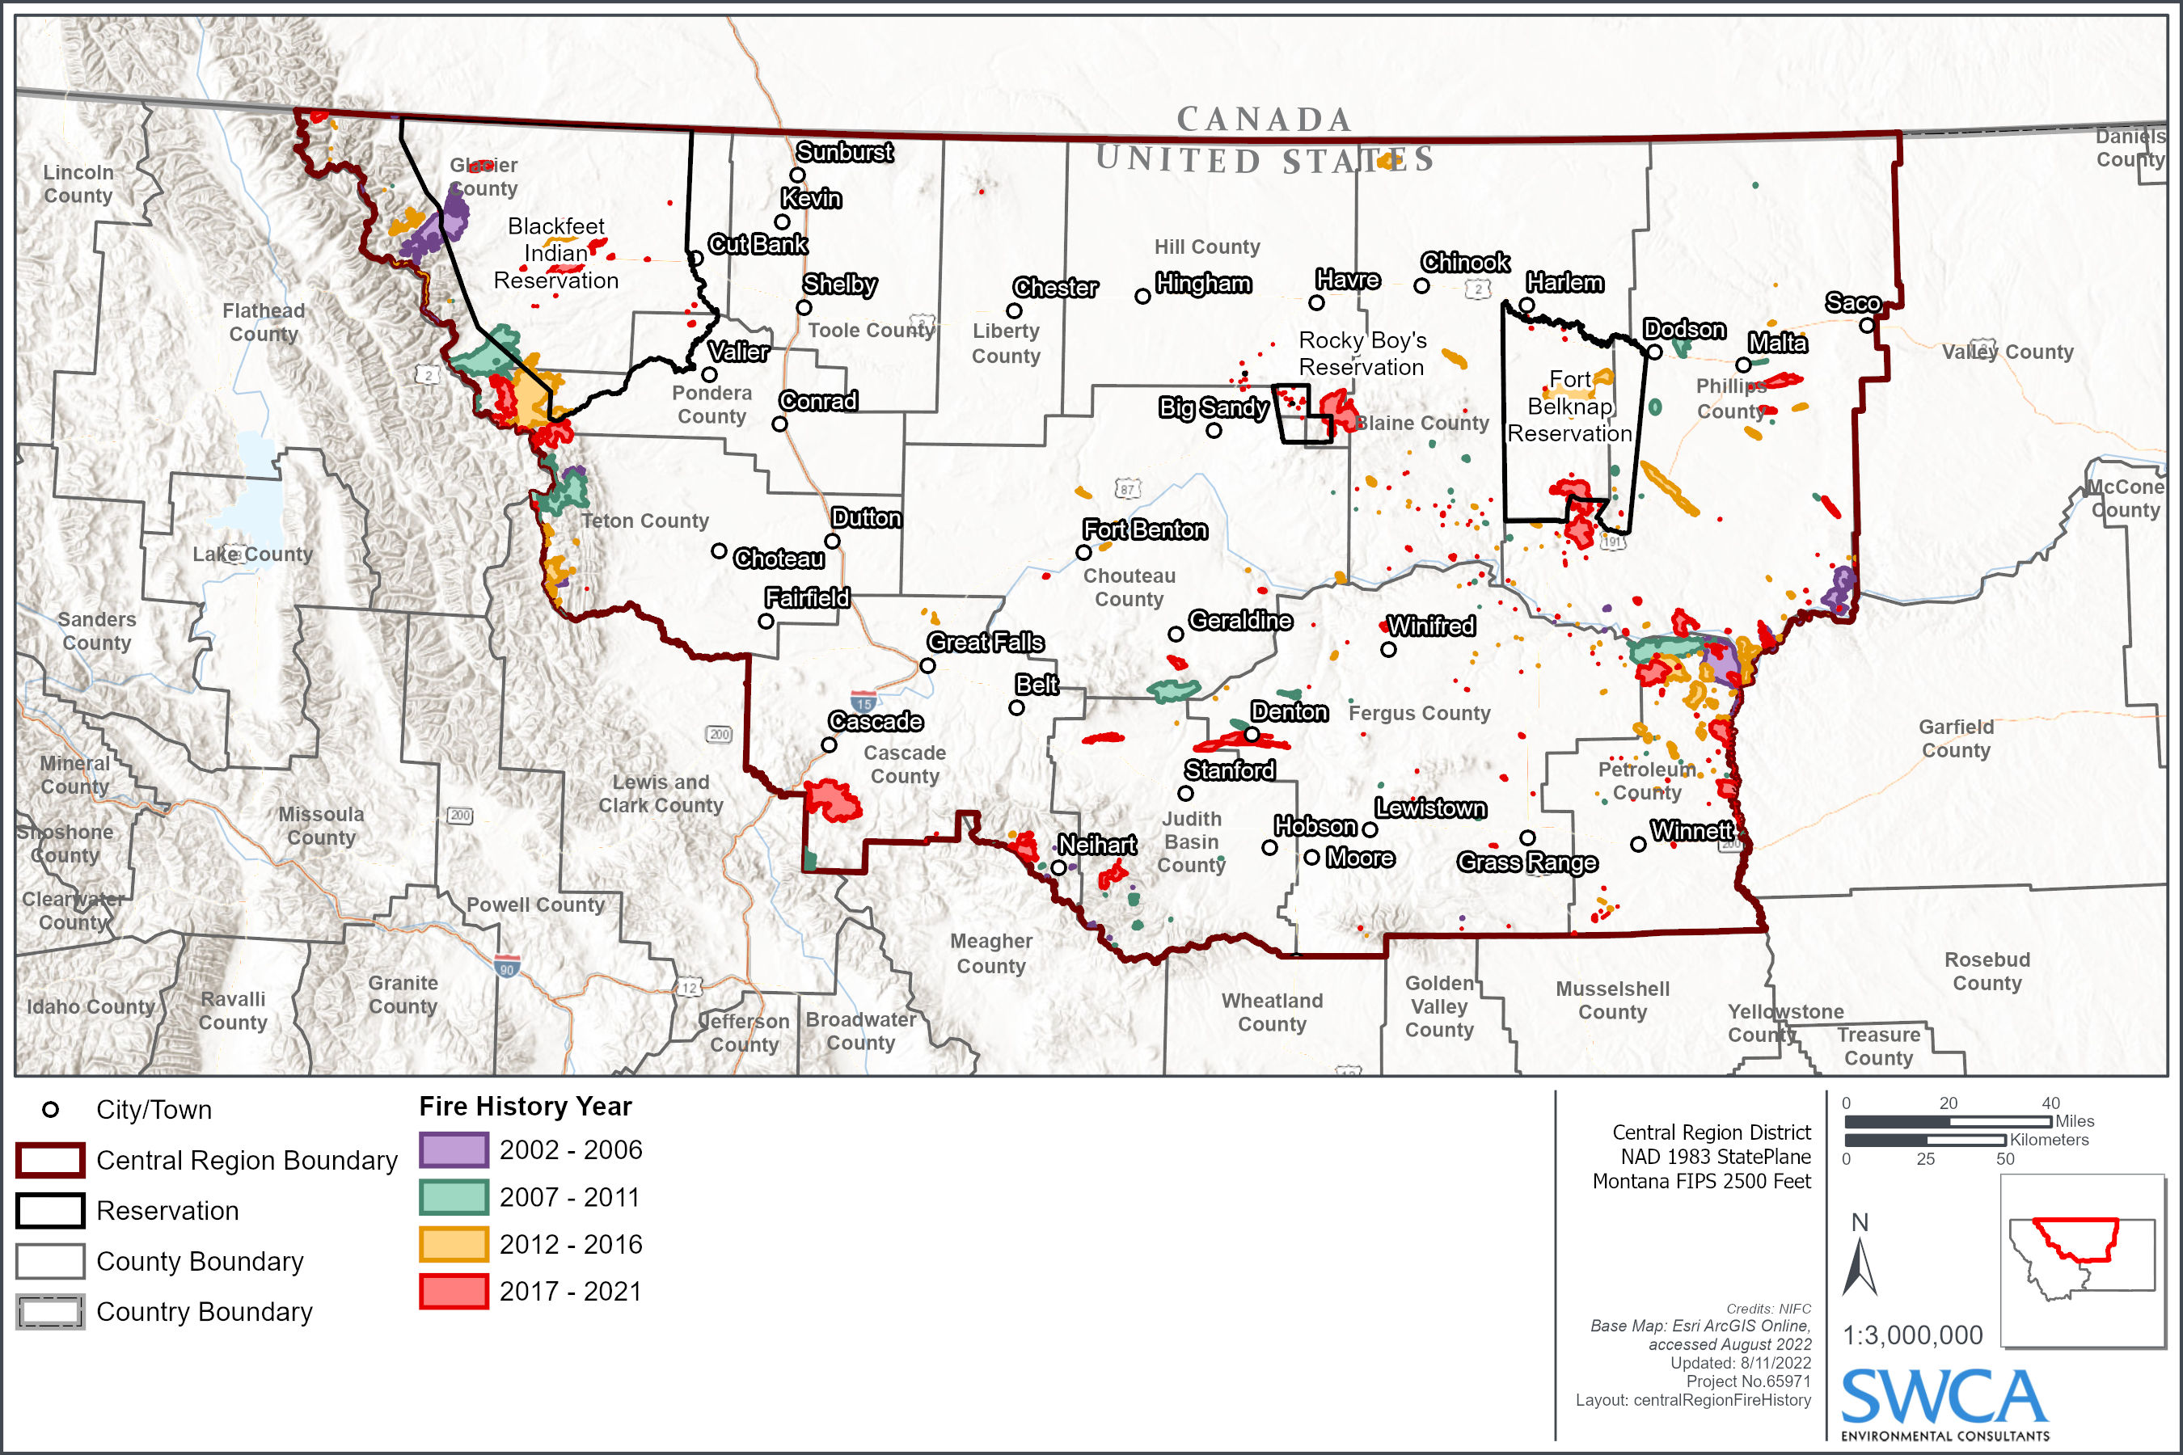
Wildland and Rangeland Fire
Location: Can occur anywhere in the Central in wildland and rangelands.
Extent: Can be small (less than 10 acres) with minimal damage, or very large and destructive (Lodgepole Complex in 2017 burned 270,000 acres)
Probability: Highly Likely throughout the planning area, 435 reported fires (of all size) from 2002-2021 in the Central Region
Impacts:
Health and safety of people
Large scale structural damage
Road closures
Power and communication failure
Damage to rivers and streams, reduced water quality from ash and debris
Erosion that can lead to increased flooding
Significant economic damages from repairs and business interruption
Loss of biodiversity
Notes:
Includes rockfall, debris flow as well as slumps
Spring is typical landslide/rockfall season

Slide 42
Wildland and Rangeland Fire Risk Assessment
Maps with latest Montana Wildfire Risk Assessment (MWRA) Wildfire Risk (Hazard + Values)
Utilizes
likelihood of fire burning
the intensity of a potential fire
the exposure of assets and resources based on their location
the susceptibility of those assets and resources
Updated with wildfire incidents
Warmer temperatures, drier summers, and longer fire seasons are exacerbating the wildfire risk.
Invasive species, forest pathogens, and fire suppression have exacerbated hazardous fuel conditions in forests and rangelands

Slide 43
Wildland and Rangeland Fire – County Parcel Analysis
County | Improved Parcels | Improved Value | Content Value | Total Value | Population
Blaine | 285 | $41,009,602 | $33,865,530 | $74,875,132 | 311
Cascade | 2,409 | $774,453,415 | $528,358,146 | $1,302,811,561 | 4,377
Chouteau | 410 | $98,029,072 | $105,687,814 | $203,716,886 | 367
Fergus | 918 | $189,616,660 | $125,775,385 | $315,392,045 | 1,263
Glacier | 273 | $44,651,636 | $36,624,195 | $81,275,831 | 377
Hill | 438 | $118,336,307 | $95,951,054 | $214,287,361 | 548
Judith Basin | 236 | $48,185,516 | $43,246,298 | $91,431,814 | 292
Liberty | 159 | $26,798,121 | $21,910,561 | $48,708,682 | 203
Petroleum | 42 | $4,561,990 | $4,469,100 | $9,031,090 | 7
Phillips | 274 | $44,619,766 | $36,190,663 | $80,810,429 | 303
Pondera | 386 | $70,127,830 | $54,618,650 | $124,746,480 | 572
Teton | 515 | $117,238,280 | $83,607,074 | $200,845,354 | 718
Toole | 454 | $91,022,746 | $82,556,953 | $173,579,699 | 660
Total | 6,799 | $1,668,650,941 | $1,252,861,421 | $2,921,512,362 | 9,997
County | Improved Parcels | Improved Value | Content Value | Total Value | Population
Blaine | 587 | $48,776,479 | $26,817,503 | $75,593,982 | 1,491
Cascade | 15,150 | $3,195,738,469 | $1,795,841,433 | $4,991,579,902 | 33,803
Chouteau | 1,472 | $160,158,103 | $97,621,402 | $257,779,505 | 3,314
Fergus | 2,682 | $337,970,597 | $184,329,996 | $522,300,593 | 5,391
Glacier | 1,099 | $119,728,018 | $70,813,251 | $190,541,269 | 3,172
Hill | 4,058 | $696,755,410 | $400,104,531 | $1,096,859,941 | 9,591
Judith Basin | 706 | $55,077,083 | $31,360,647 | $86,437,730 | 1,410
Liberty | 554 | $57,655,214 | $33,587,862 | $91,243,076 | 1,389
Petroleum | 73 | $8,773,250 | $6,678,315 | $15,451,565 | 90
Phillips | 1,053 | $111,338,242 | $62,482,983 | $173,821,225 | 2,208
Pondera | 1,582 | $204,308,542 | $123,640,000 | $327,948,542 | 4,175
Teton | 1,038 | $158,754,606 | $96,772,170 | $255,526,776 | 2,249
Toole | 1,369 | $162,753,992 | $103,625,811 | $266,379,803 | 2,995
Total | 31,423 | $5,317,788,005 | $3,033,675,901 | $8,351,463,906 | 71,277
High risk to wildfire
Very high risk to wildfire
County | Improved Parcels | Improved Value | Content Value | Total Value | Population
Blaine | 464 | $50,981,226 | $26,961,623 | $77,942,849 | 1,229
Cascade | 1,536 | $319,625,388 | $162,492,545 | $482,117,933 | 3,439
Chouteau | 185 | $20,737,052 | $13,276,546 | $34,013,598 | 426
Fergus | 1,262 | $153,510,525 | $81,417,223 | $234,927,748 | 2,596
Glacier | 1,254 | $127,955,403 | $69,028,269 | $196,983,672 | 3,629
Hill | 727 | $87,422,192 | $45,924,689 | $133,346,881 | 1,734
Judith Basin | 127 | $10,047,319 | $5,434,600 | $15,481,919 | 254
Liberty | 6 | $479,118 | $239,559 | $718,677 | 16
Petroleum | 167 | $11,625,245 | $8,156,330 | $19,781,575 | 315
Phillips | 459 | $47,199,901 | $29,821,830 | $77,021,731 | 970
Pondera | 25 | $1,792,836 | $915,123 | $2,707,959 | 66
Teton | 797 | $92,535,814 | $52,494,177 | $145,029,991 | 1,799
Toole | 252 | $33,686,409 | $19,595,155 | $53,281,564 | 554
Total | 7,261 | $957,598,428 | $515,757,668 | $1,473,356,096 | 17,027
Extreme risk to wildfire

Slide 44
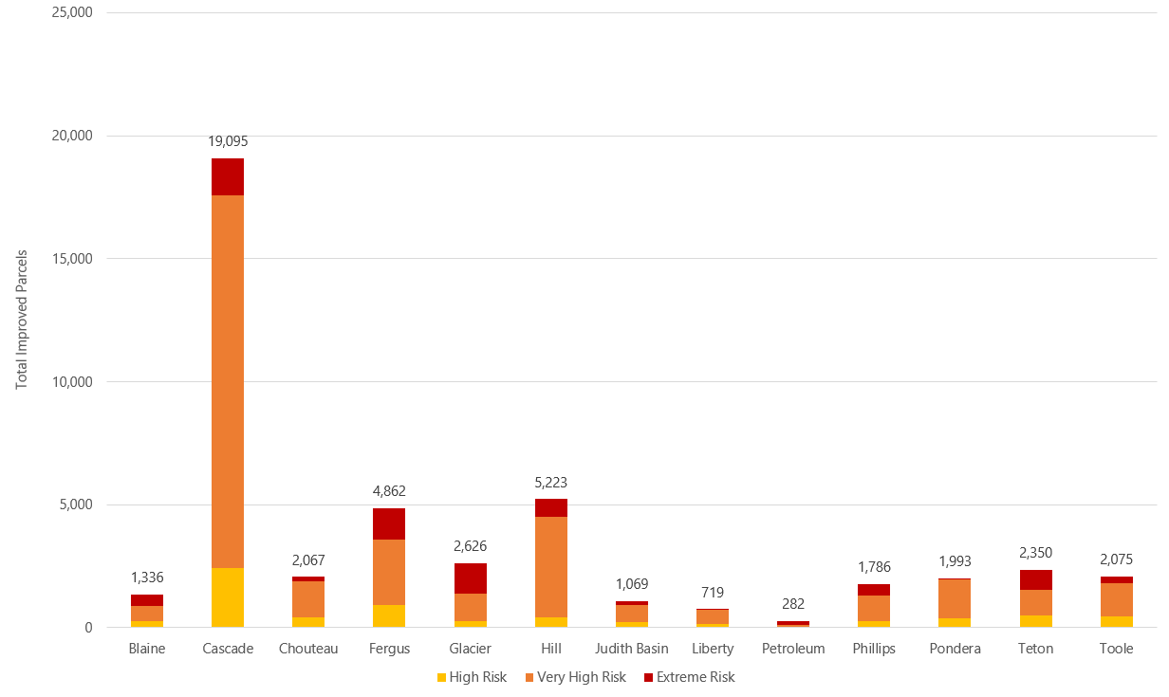
Wildland and Rangeland Fire – County Parcel Analysis
Total Improved Parcels in Wildfire Risk Areas

Slide 45
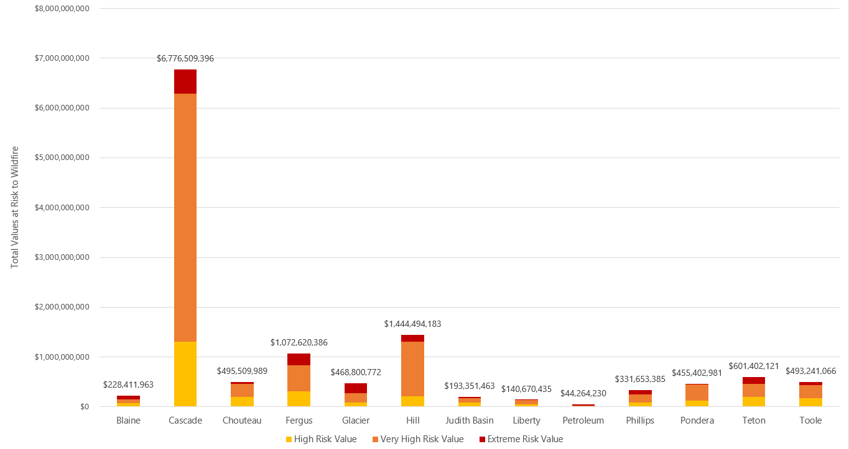
Wildland and Rangeland Fire – County Parcel Analysis
Total Values at Risk to Wildfire Areas

Slide 46
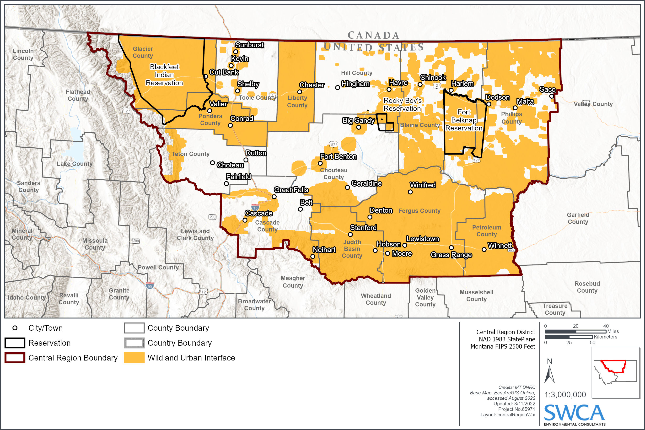
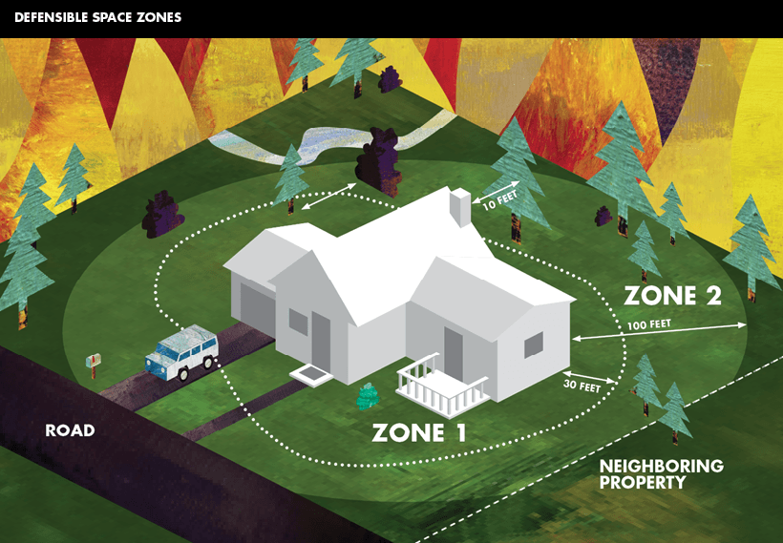
Wildland Fire – Wildland Urban Interface (WUI)
Zone of transition between wildland and developed land
Greatest risk in the municipalities of Great Falls, Lewistown, Browning, Shelby, Havre, Rocky Boy's Reservation, East Glacier Park Village, Winnett, and the exurban areas near Lewistown

Slide 47
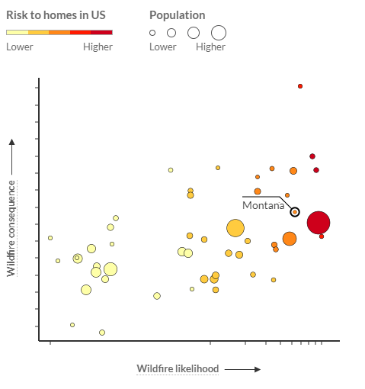
Wildland Fire - Risk to Homes per www.wildfirerisk.org
Blackfeet: Greater risk than 70% of tribal areas/counties in MT
Blaine: Greater risk than 62% of counties in MT
Cascade: Low risk compared to counties in MT
Chippewa Cree: Greater than 57% of tribal areas/counties in MT
Chouteau: Greater risk than 29% of counties in MT
Fergus: Greater risk than 22% of counties in MT
Fort Belknap: Greater risk than 81% of tribal areas/counties in MT
Glacier: Greater risk than 64% of counties in MT
Hill: Greater risk than 20% of counties in MT
Judith Basin: Greater risk than 31% of counties in MT
Liberty: Low risk compared to counties in MT
Petroleum: Greater risk than 93% of counties in MT
Phillips: Greater risk than 36% of counties in MT
Pondera: Greater risk than 16% of counties in MT
Teton: Greater risk than 25% of counties in MT
Toole: Greater risk than 7% of counties in MT

Slide 48
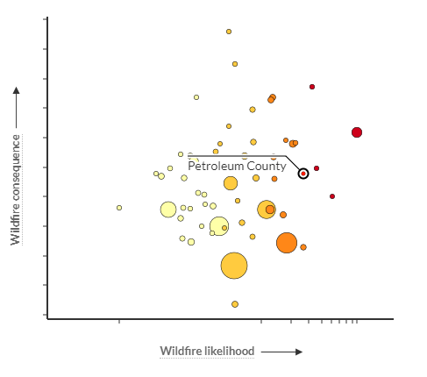
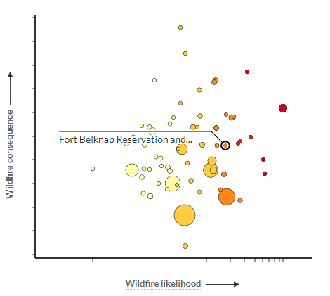
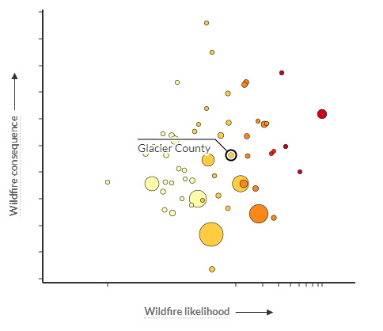
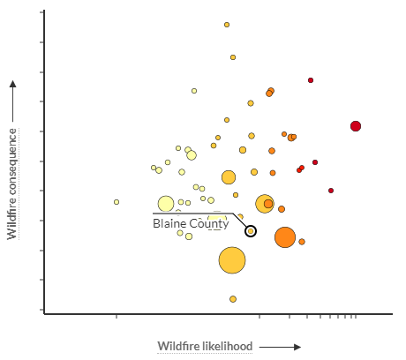
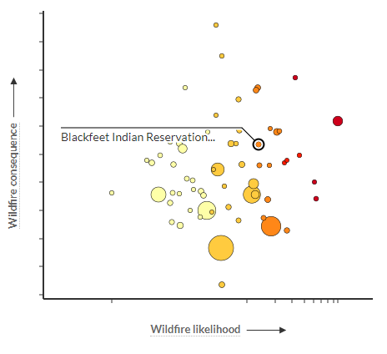
Wildland Fire - Risk to Homes per www.wildfirerisk.org
Counties in the Central Region with greater risk to homes than 50% of other counties in MT

Slide 49
Wildfire Risk Summary
Jurisdiction | Geographic Extent | Probability of Future Occurrence | Potential Magnitude/ Severity | Overall Significance
Blackfeet Tribe | Significant | Highly likely | Critical | High
Blaine County | Limited | Likely | Critical | High
Cascade County | Significant | Likely | Critical | High
Chouteau County | Limited | Likely | Limited | Medium
Fergus County | Significant | Highly likely | Limited | Medium
Fort Belknap | Limited | Likely | Critical | High
Glacier County | Significant | Highly likely | Critical | High
Hill County | Limited | Likely | Limited | Medium
Judith Basin County | Limited | Likely | Limited | Medium
Liberty County | Limited | Likely | Limited | Medium
Petroleum County | Significant | Highly likely | Critical | High
Phillips County | Limited | Highly likely | Limited | Medium
Pondera County | Limited | Highly likely | Limited | Medium
Rocky Boy | Limited | Highly likely | Limited | Medium
Teton County | Limited | Highly likely | Limited | Medium
Toole County | Limited | Unlikely | Limited | Medium
What do you think the significance of wildland and rangeland fire is for your jurisdiction?
ⓘ Start presenting to display the poll results on this slide.

Slide 50
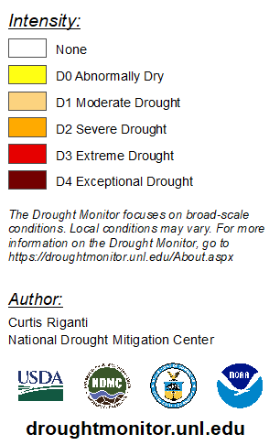
Drought
August 3, 2021
139 USDA Disaster Designations (2012-2021) regionwide
Greatest number of designations in 2021 (51) and 2017 (47)
USDA RMA records 5,176,232 insured acres lost and $319,751,544 indemnity payments
41% of losses recorded in 2021
13% losses to forage production
Drought Impact Reporter notes most impacts since 2000:
Agriculture
Relief, Response & Restrictions
Water Supply & Quality
Plants & Wildlife
Fire
Tourism & Recreation
August 2, 2022
Notes:
2017 and 2021 were bad drought years
Current Impacts from 2021-2022 drought:
Blaine County - Affected water use in. Huge concerns for county commissioners and ag producers
City of Harlem (Blaine County) - Multiple farmers have lost crops
Fergus County – Crops and landscape showing signs of stress. Producers hauling water, Culling cattle. Fire restrictions
Petroleum County – Crop and grazing losses. Significant reduction in livestock numbers
Town of Hingham (Hill County) – Trees in park have suffered. 3 removed.

Slide 51
Drought
National Risk Index – Annualized Frequency
National Risk Index – Expected Annual Loss Rating

Slide 52
Jurisdiction | Geographic Extent | Probability of Future Occurrence | Potential Magnitude/ Severity | Overall Significance
Regionwide | Extensive | Likely | Critical | Medium
What do you think the significance of drought is for your jurisdiction?
ⓘ Start presenting to display the poll results on this slide.

Slide 53
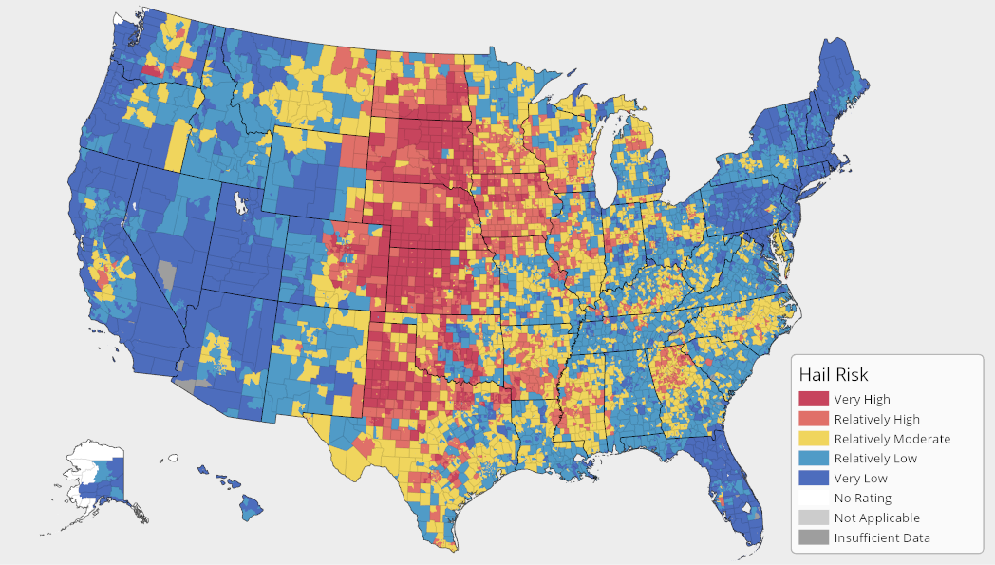
Severe Summer Weather
Location: All counties in the Central Region experience severe summer weather events
Extent: Can cause extensive damage to property and environment, as well as threaten human life. Hail is the most damaging summer event.
Probability: Highly likely in the Central Region, with 629 days with a reported event over 72 years. Hail is most reported event.
Impacts:
Injury to people and fatalities
Property damage (roofs, cars, and windows)
Road closure and flash flooding due to hail accumulation and heavy rain
Power and communication failure due to lightning
Economic losses due to repairs - hail is the costliest insured hazard in the US
Damaged crops, landscape, and other vegetation
Structure fires and wildfires ignited by lightning
Source: FEMA
 | Deaths | Injuries | Property Loss | Crop Loss | Days with Events | Total Events
Excessive Heat | 0 | 0 | $0 | $0 | 3 | 8
Hail | 0 | 2 | $2,565,600 | $2,287,000 | 561 | 1,598
Heavy Rain | 0 | 0 | $0 | $0 | 58 | 113
Lightning | 1 | 5 | $20,000 | $0 | 7 | 7
Total | 1 | 7 | $2,585,600 | $2,287,000 | 629 | 1,726
Source: NCEI
Notes:
Excessive Heat is by zone

Slide 54
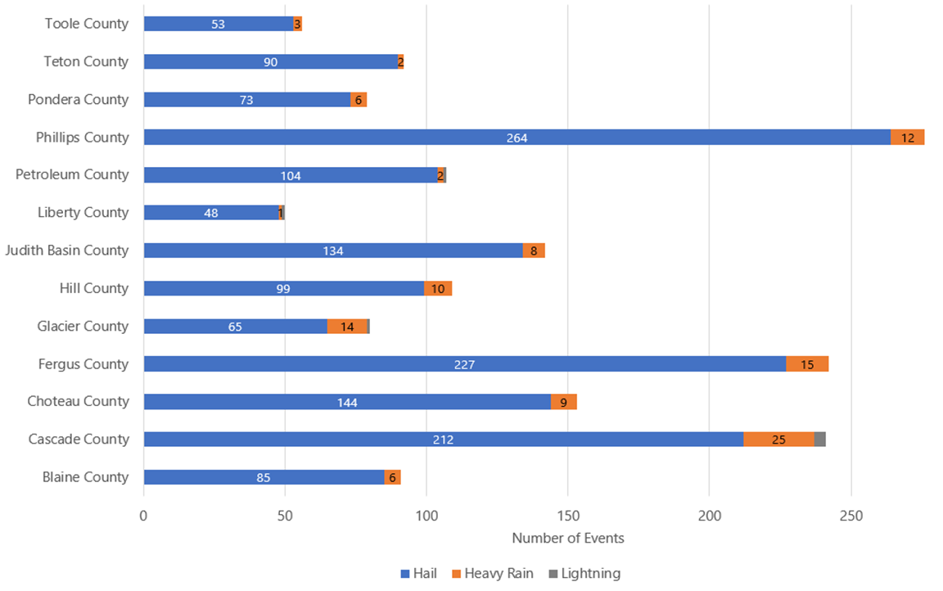
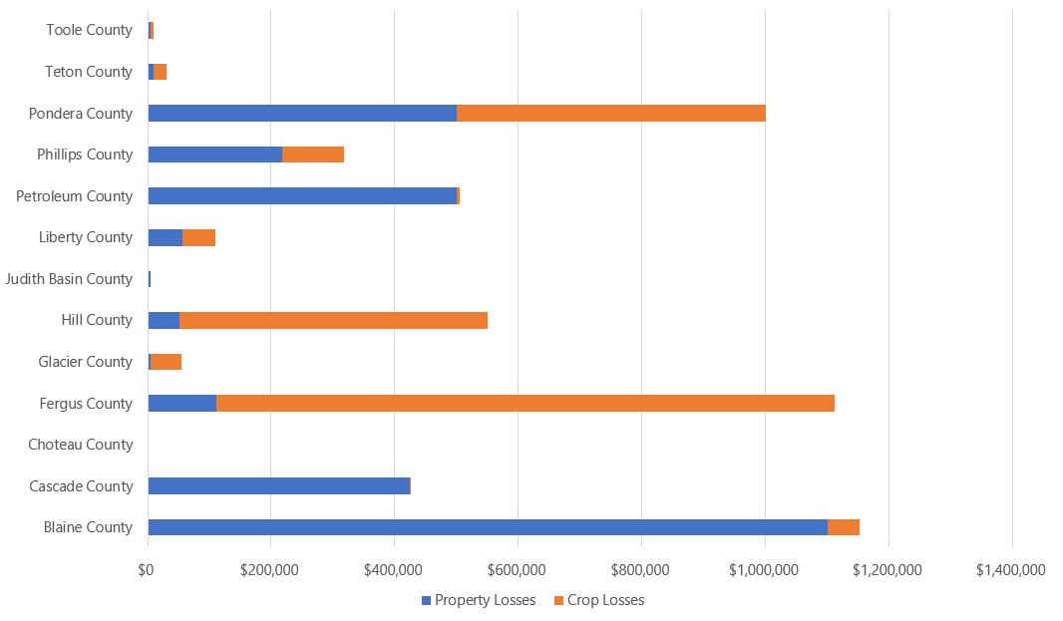
Severe Summer Weather
Phillips, Fergus, and Cascade Counties experience the highest frequency of summer weather events
Blaine, Fergus, and Pondera Counties have experienced the greatest losses from severe summer weather

Slide 55
Severe Summer Weather Risk Summary
Jurisdiction | Geographic Extent | Probability of Future Occurrence | Potential Magnitude/ Severity | Overall Significance
Blackfeet | Extensive | Likely | Limited | Medium
Blaine | Extensive | Likely | Critical | High
Cascade | Extensive | Highly Likely | Limited | Medium
Rocky Boy | Extensive | Highly Likely | Limited | Medium
Chouteau | Extensive | Highly Likely | Limited | Medium
Fergus | Extensive | Highly Likely | Critical | High
Fort Belknap | Extensive | Likely | Critical | High
Glacier | Extensive | Likely | Limited | Medium
Hill | Extensive | Likely | Limited | Medium
Judith Basin | Extensive | Likely | Limited | Medium
Liberty | Extensive | Likely | Limited | Medium
Petroleum | Extensive | Likely | Limited | Medium
Phillips | Extensive | Highly Likely | Limited | Medium
Pondera | Extensive | Likely | Critical | High
Teton | Extensive | Likely | Limited | Medium
Toole | Extensive | Likely | Limited | Medium
What do you think the significance of severe summer weather is for your jurisdiction?
ⓘ Start presenting to display the poll results on this slide.

Slide 56
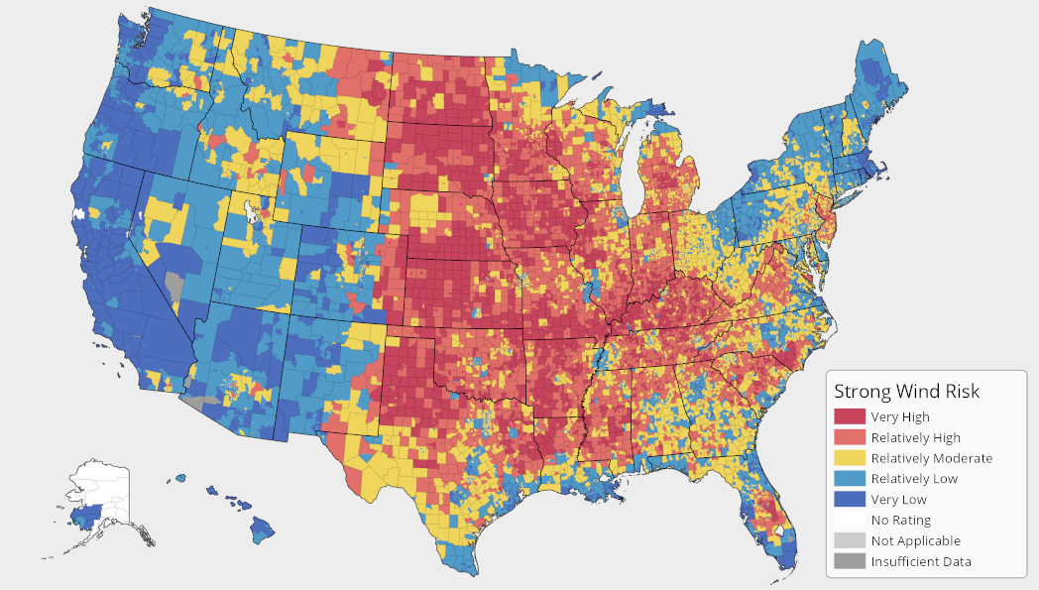
Tornadoes & Windstorms
Location: Can occur anywhere in the Central Region. Most reported events in Cascade and Phillips Counties
Extent: Wind/tornadoes can cause extensive damage to property, crops, and threaten human life
Probability: Highly likely that a wind event or tornado event will occur in the Central Region annually, with 1,412 days with recorded events in the past 72 years
Impacts:
Threatened life and safety of people
Structural and property damage
Road closures from debris
Power and communication failure
Damages to critical facilities such as water treatment plants
Economic losses from repair and business interruptions
Source: FEMA
 | Deaths | Injuries | Property Loss | Crop Loss | Days with Events | Total Events
High Wind | 2 | 10 | $1,526,000 | $0 | 853 | 2,838
Strong Wind | 0 | 0 | $20,000 | $0 | 5 | 12
Thunderstorm Wind | 0 | 2 | $12,364,700 | $1,555,000 | 467 | 1,286
Tornadoes | 0 | 11 | $10,969,810 | $50,000 | 87 | 119
Total | 2 | 23 | $24,880,510 | $1,605,000 | 1,412 | 4,255
Source: NCEI
Notes:
Important to note that high wind and strong wind hazards are recorded on a zonal scale, so it is possible that there are repeats in the losses, therefore estimate losses from NCEI might be higher than actual losses. Tornadoes and thunderstorm winds are on county scale, so those estimates in the table are more accurate

Slide 57
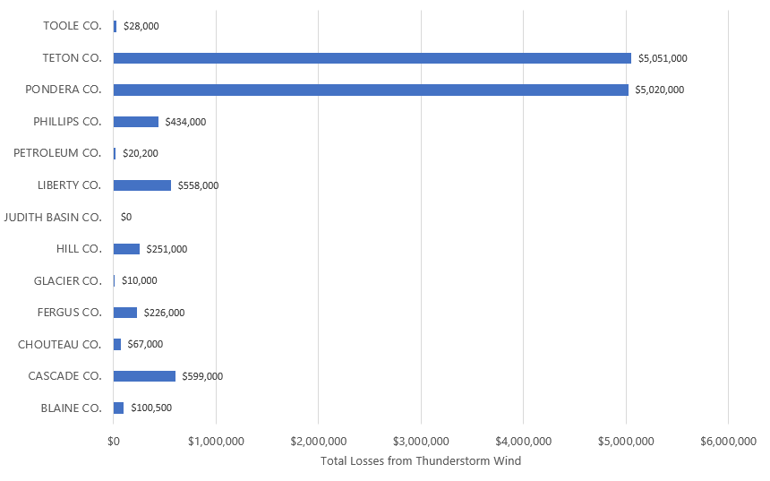
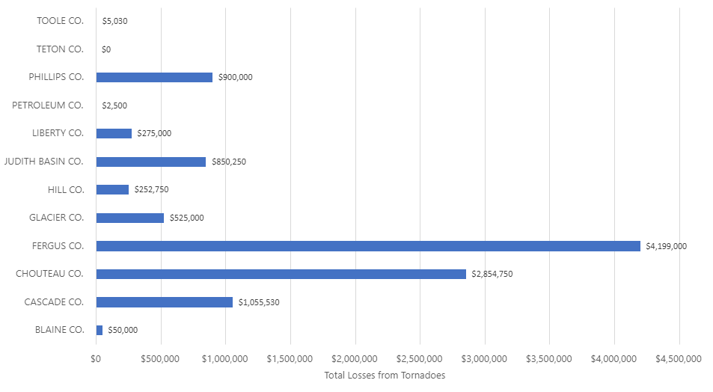
Tornadoes & Windstorms
Greatest losses from thunderstorm winds in Teton County and Pondera County
Greatest losses from tornadoes in Fergus County and Chouteau County
Notes:
Teton & Ponderosa are same $5M event

Slide 58
Tornadoes & Windstorms Risk Summary
Jurisdiction | Geographic Extent | Probability of Future Occurrence | Potential Magnitude/ Severity | Overall Significance
Blackfeet | Extensive | Likely | Limited | Medium
Blaine | Extensive | Likely | Limited | Medium
Cascade | Extensive | Highly Likely | Limited | Medium
Rocky Boy | Extensive | Highly Likely | Limited | Medium
Chouteau | Extensive | Likely | Critical | High
Fergus | Extensive | Highly Likely | Critical | High
Fort Belknap | Extensive | Likely | Limited | Medium
Glacier | Extensive | Likely | Limited | Medium
Hill | Extensive | Highly Likely | Limited | Medium
Judith Basin | Extensive | Likely | Limited | Medium
Liberty | Extensive | Likely | Limited | Medium
Petroleum | Extensive | Likely | Limited | Medium
Phillips | Extensive | Highly Likely | Limited | Medium
Pondera | Extensive | Likely | Critical | High
Teton | Extensive | Likely | Critical | High
Toole | Extensive | Likely | Limited | Medium
What do you think the significance of tornadoes & windstorms is for your jurisdiction?
ⓘ Start presenting to display the poll results on this slide.

Slide 59
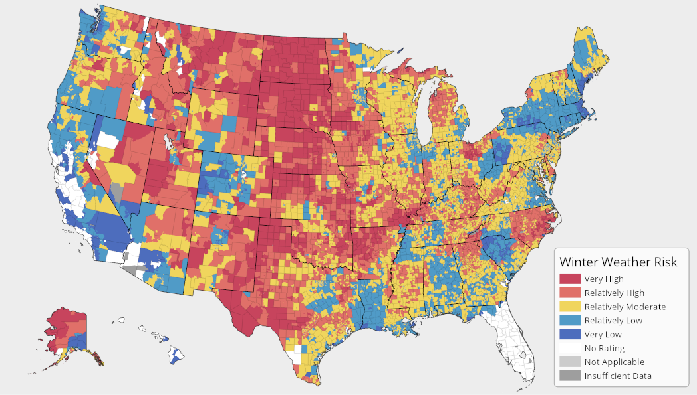
Severe Winter Storm
Location: All counties in the Central Region experience severe winter storm events
Extent: Can cause significant property losses, injuries, and fatalities.
Probability: Highly likely to occur every year in the Central Region, with 882 days with events reported over 26 years
Impacts:
Structural damage from snow and ice accumulation
Isolation due to road closures and increased car accidents/pileups
Power and communication failure
Threatens health and safety of humans, livestock, and animals caught outside
Tree and vegetation damages
Source: FEMA
 | Deaths | Injuries | Property Loss | Days with Events | Total Events
Blizzard | 1 | 7 | $50,000 | 60 | 170
Cold/Wind Chill | 0 | 0 | $0 | 52 | 196
Heavy Snow | 0 | 0 | $1,000 | 380 | 760
Ice Storm | 0 | 0 | $0 | 6 | 12
Winter Storm | 0 | 0 | $8,249,000 | 316 | 855
Winter Weather | 0 | 3 | $0 | 65 | 105
Total | 1 | 10 | $8,300,000 | 882 | 2,098
Source: NCEI
Notes:
Important to note that all winter weather hazards are recorded on a zonal scale, so it is possible that there are repeats in the losses, therefore estimate losses from NCEI might be higher than actual losses

Slide 60
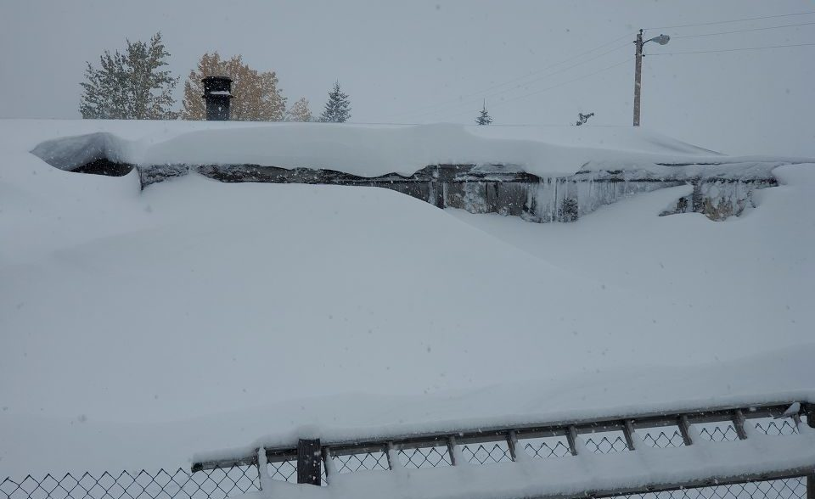
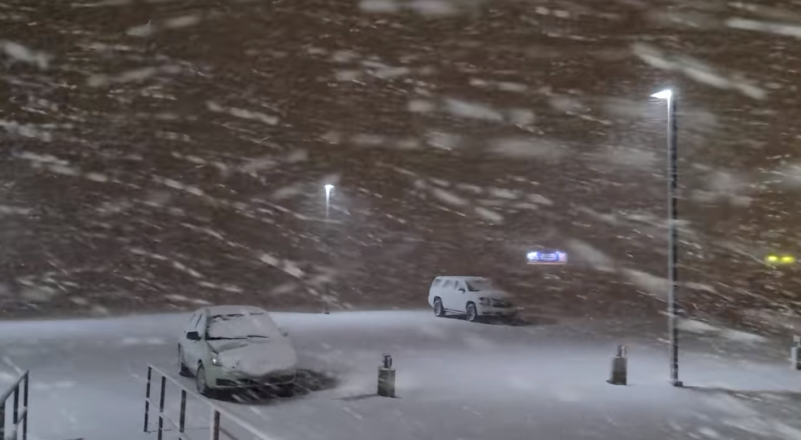
Severe Winter Storm
Hazard Risk Summary Table
Home buried in snow in Great Falls, Montana, Source: Electroverse, Sept. 2019
Jurisdiction | Geographic Extent | Probability of Future Occurrence | Potential Magnitude/ Severity | Overall Significance
Blackfeet | Extensive | Highly Likely | Limited | Medium
Blaine | Extensive | Highly Likely | Limited | Medium
Cascade | Extensive | Highly Likely | Limited | Medium
Rocky Boy’s | Extensive | Highly Likely | Limited | Medium
Chouteau | Extensive | Highly Likely | Critical | High
Fergus | Extensive | Highly Likely | Critical | High
Fort Belknap | Extensive | Highly Likely | Limited | Medium
Glacier | Extensive | Highly Likely | Limited | Medium
Hill | Extensive | Highly Likely | Limited | Medium
Judith Basin | Extensive | Highly Likely | Limited | Medium
Liberty | Extensive | Highly Likely | Limited | Medium
Petroleum | Extensive | Highly Likely | Limited | Medium
Phillips | Extensive | Highly Likely | Limited | Medium
Pondera | Extensive | Highly Likely | Critical | High
Teton | Extensive | Highly Likely | Critical | High
Toole | Extensive | Highly Likely | Limited | Medium
Major winter storm hits north-central Montana, Source: NWS, 2021
Notes:
All winter weather is by zone

Slide 61
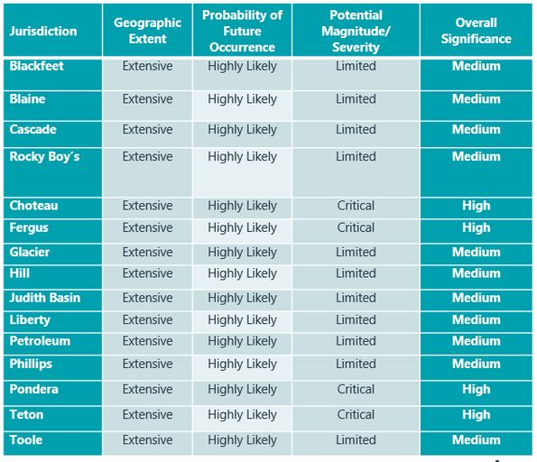
What do you think the significance of severe winter weather is for your jurisdiction?
ⓘ Start presenting to display the poll results on this slide.

Slide 62
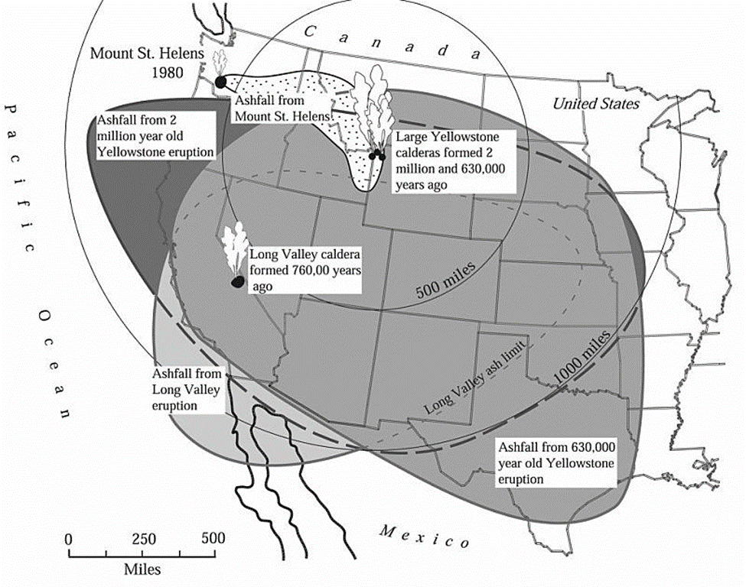
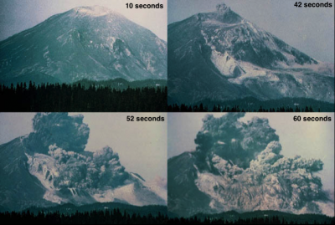
Volcanic Ash
Areas of US with volcanic ash deposits
Major concern for Montana is ashfall after an eruption, most likely from the Cascades in WA, OR, and CA
Yellowstone Caldera in WY and ID presents some risk, although much less likely based on the geologic record
1980 Mt. St Helens eruption is best recent example
Unlike ash from fires, volcanic ash is hard, does not dissolve in water, is extremely abrasive, and can conduct electricity when wet
Leads to massive damage to machinery
Can scratch skin and eyes; create a cement-like mixture in the lungs if inhaled
Massive cleanup costs, as ash must be collected and trucked away
Can collapse roofs under weight if too much accumulates
Large scale ejections of ash can even alter the global climate

Slide 63
Volcanic Ash
Hazard Risk Summary Table
Jurisdiction | Geographic Extent | Probability of Future Occurrence | Potential Magnitude/ Severity | Overall Significance
Regionwide | Extensive | Unlikely | Limited | Low
What do you think the significance of volcanic ash is for your jurisdiction?
ⓘ Start presenting to display the poll results on this slide.

Slide 64
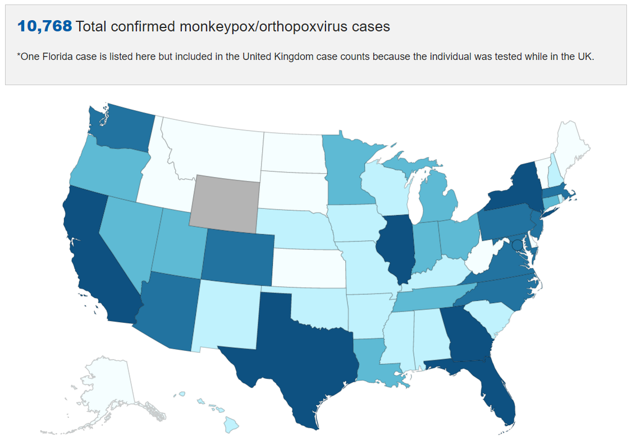
Communicable Disease
2022 US Monkeypox Outbreak
United States: 10,768 confirmed cases as of 8/11/22
Montana: 2 confirmed cases as of 8/11/22
Five pandemic in the last ~100 years
- 1918-1919 Spanish Flu (H1N1) – 17 to 100 million deaths​
- 1957-1958 Asian Flu (H2N2) – 1 to 4 million deaths​
- 1968-1969 Hong Kong Flu (H3N2) – 1 to 4 million deaths​
- 2009 H1N1 Flu – 18,000 deaths​
- 2020-Current COVID-19
Worldwide: 568 million cases, 6.38 million deaths as of 7/22/22
United States: 90.2 million cases, 1.02 million deaths as of 7/22/22​
State of Montana: 294,340 cases, 3,467 deaths as of 7/22/2022
Montana Central Region: 47,463 cases, 698 deaths as of 7/22/22​
Other major/popular communicable diseases in the State of Montana
- Hantavirus Pulmonary Syndrome (deer mouse as the virus reservoir)
- STDs, Hepatitis, Food & Water borne Diseases (according to Montana DPHHS

Slide 65
Communicable Disease
Hazard Risk Summary Table
Jurisdiction | Geographic Extent | Probability of Future Occurrence | Potential Magnitude/ Severity | Overall Significance
Blackfeet | Extensive | Occasional | Critical | Medium
Blaine | Extensive | Occasional | Critical | Medium
Cascade | Extensive | Occasional | Critical | Medium
Rocky Boy’s | Extensive | Occasional | Critical | Medium
Chouteau | Extensive | Occasional | Critical | Medium
Fergus | Extensive | Occasional | Critical | Medium
Glacier | Extensive | Occasional | Critical | Medium
Hill | Extensive | Occasional | Critical | Medium
Judith Basin | Extensive | Occasional | Critical | Medium
Liberty | Extensive | Occasional | Critical | Medium
Petroleum | Extensive | Occasional | Critical | Medium
Phillips | Extensive | Occasional | Critical | Medium
Pondera | Extensive | Occasional | Critical | Medium
Teton | Extensive | Occasional | Critical | Medium
Toole | Extensive | Occasional | Critical | Medium
A pandemic occurs on average roughly every 20 years
There is a 5% chance that a pandemic that affects the entire US will occur in any given year
New study finds climate change could spark the next pandemic
Effects on people will vary, while the elderly, people with underlying medical conditions, and young children are usually at higher risk
Ongoing mitigation activities should focus on disease prevention, especially during flu season
Pre-season community outreach campaigns to educate the public about risks and available support; establish convenient vaccination centers; reach out to vulnerable populations and caregivers; and issuing advisories and warnings.

Slide 66
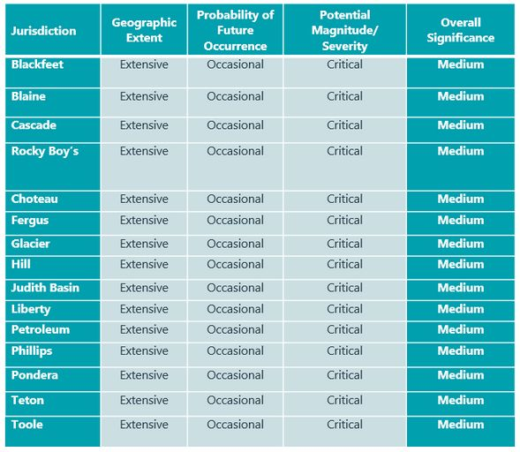
What do you think the significance of communicable disease is for your jurisdiction?
ⓘ Start presenting to display the poll results on this slide.

Slide 67
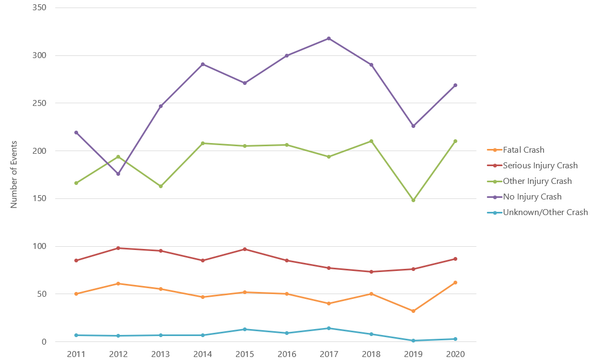
Transportation Accidents
Crash Severity in Montana 2011-2020
Location: All counties in the Central Region can experience transportation accidents, often along U.S. Highway 2, U.S. Route 191, U.S. Route 87, and Interstate 15.
Extent: Can cause significant property losses, injuries, and fatalities to those involved in the accident.
Probability: Highly likely
9 aircraft accidents per year in the state
4,240 annual average roadway crashes from 2016-2020 in the Central Region
7,163 annual average roadway crashes due to wildlife in the state (most often caused by white-tailed deer in the month of Nov.)
82 boating accidents from 2017-2021 in the state
37 reported train accidents in the Central Region from 2017-2021
Impacts:
Isolation/delayed emergency response due to road closure
Property damage
Threaten to life and safety
Source: MT DOT
Notes:
Includes rockfall, debris flow as well as slumps
Spring is typical landslide/rockfall season

Slide 68
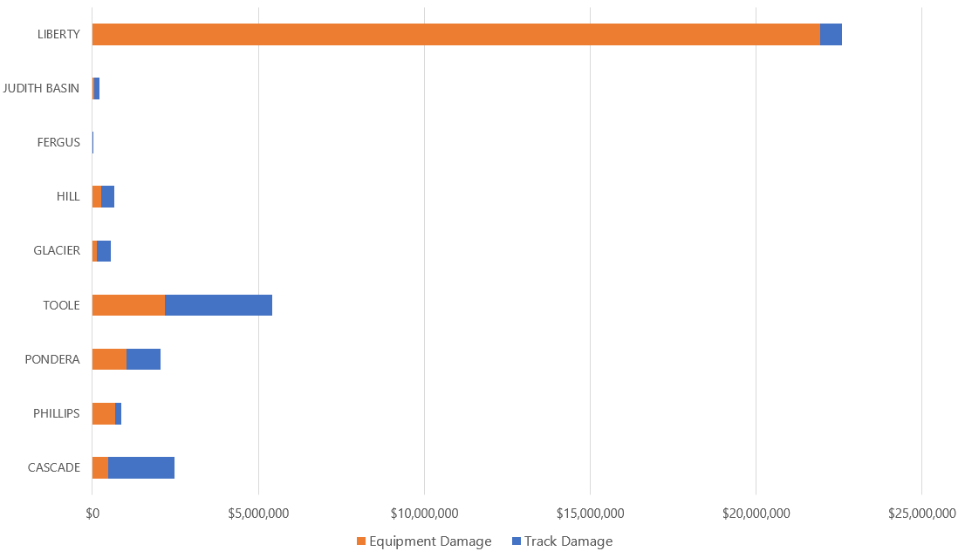
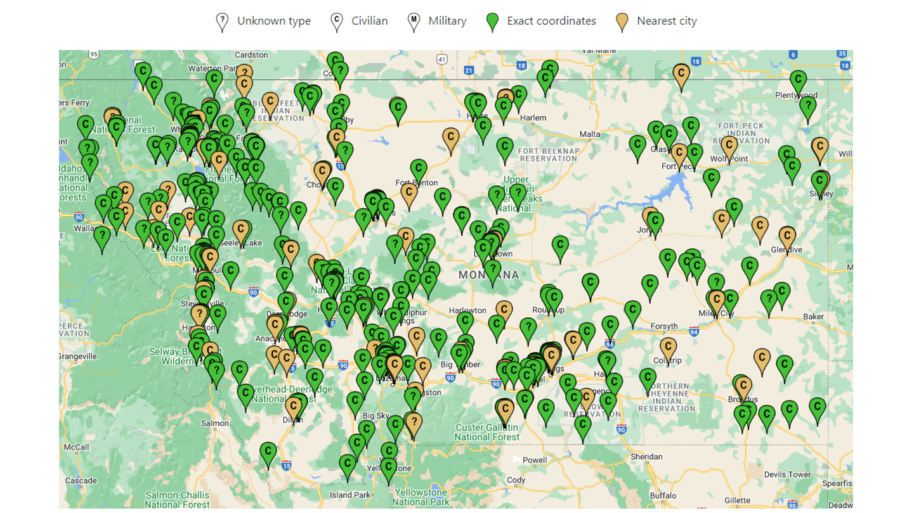
Transportation Accidents
Central Region Railway Accidents 2017-2021
Montana Aircraft Crashes 1964-2018
Source: National Transportation Safety Board (map compiled by: Lee C. Baker / Crosswind Software, LLC)
Source: Federal Railway Administration

Slide 69
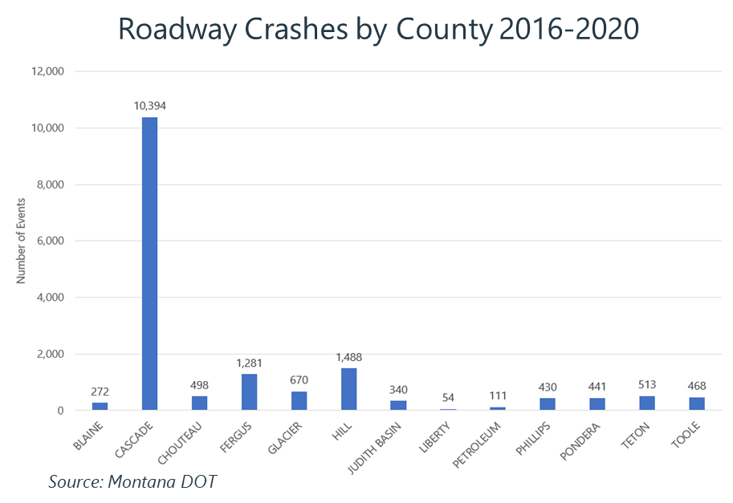
Transportation Accidents
Hazard Risk Summary Table
Jurisdiction | Geographic Extent | Probability of Future Occurrence | Potential Magnitude/ Severity | Overall Significance
Blackfeet | Significant | Highly Likely | Negligible | Low
Blaine | Significant | Highly Likely | Negligible | Low
Cascade | Significant | Highly Likely | Limited | Medium
Rocky Boy’s | Significant | Highly Likely | Negligible | Low
Chouteau | Significant | Highly Likely | Negligible | Low
Fergus | Significant | Highly Likely | Negligible | Low
Fort Belknap | Significant | Highly Likely | Negligible | Low
Glacier | Significant | Highly Likely | Negligible | Low
Hill | Significant | Highly Likely | Negligible | Low
Judith Basin | Significant | Highly Likely | Negligible | Low
Liberty | Significant | Highly Likely | Limited | Medium
Petroleum | Significant | Highly Likely | Negligible | Low
Phillips | Significant | Highly Likely | Negligible | Low
Pondera | Significant | Highly Likely | Negligible | Low
Teton | Significant | Highly Likely | Negligible | Low
Toole | Significant | Highly Likely | Limited | Medium

Slide 70
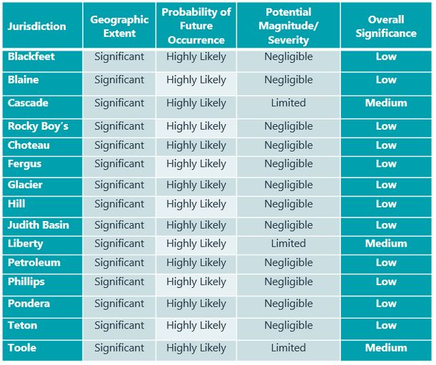
What do you think the significance of transportation accidents is for your jurisdiction?
ⓘ Start presenting to display the poll results on this slide.

Slide 71
Hazardous Materials - Spills/ Accidents Reported to the NRC Central Region 1990-2022
Location: Hazmat incidents can occur at a fixed facility or during transportation. Hazardous materials facilities are identified and mapped by the counties they reside in, along with the types of materials stored there; facilities generally reside in and around communities.
Probability: Likely throughout the planning area
Montana’s Central Region has had 397 Hazmat Spill incidents in 32 years.
2017 – 2020 saw some of the highest amounts in this timeframe.

Slide 72
Hazardous Materials – Incidents Reported to the NRC by Type
The largest amount of Hazardous Material Incidents reported to the NRC by type are Fixed with 39% of the 397 events reported.
Fixed Facilities such as Tier II and RMP facilities are common places where hazardous material incidents occur.
The second largest amount are mobile incidents with 16%. When Hazardous Materials are being transported and accidents occur.
The third largest amount is Railroad incidents with 15% which again involves transporting Hazardous Materials.

Slide 73
Hazardous Materials - Spills/ Accidents Reported to the NRC Central Region by County
Between 1990 and 2022 the Central Region has seen an average of 12 NRC-reported incidents per year
Cascade, Glacier and Hill counties have had the highest amount of hazmat incidents and spills.

Slide 74
Hazardous Materials – Risk Summary Table
Jurisdiction | Geographic Extent | Probability of Future Occurrence | Potential Magnitude/ Severity | Overall Significance
Central Region | Limited | Likely | Limited | Low
Blackfeet Tribe | Limited | Unlikely | Limited | Low
Blaine County | Limited | Likely | Limited | Low
Cascade County | Limited | Likely | Limited | High
Chouteau County | Limited | Unlikely | Limited | Low
Fergus County | Limited | Unlikely | Limited | Low
Fort Belknap Indian Community | Limited | Unlikely | Limited | Low
Glacier County | Limited | Likely | Limited | Medium
Hill County | Limited | Likely | Limited | Low
Judith Basin County | Limited | Unlikely | Limited | Low
Liberty County | Limited | Unlikely | Limited | Low
Petroleum County | Limited | Unlikely | Limited | Low
Phillips County | Limited | Unlikely | Limited | Low
Pondera County | Limited | Unlikely | Limited | Low
Rocky Boy Montana (Chippewa Cree Tribes) | Limited | Unlikely | Limited | Low
Teton County | Limited | Unlikely | Limited | Low
Toole County | Limited | Unlikely | Limited | Low

Slide 75
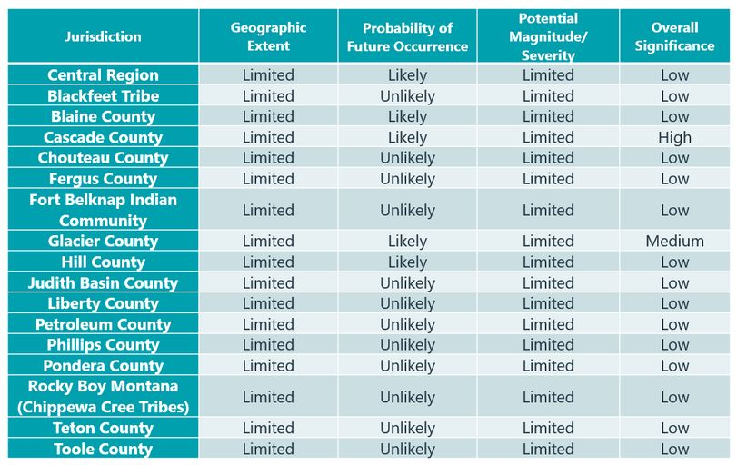
What do you think the significance of hazardous material incidents is for your jurisdiction?
ⓘ Start presenting to display the poll results on this slide.

Slide 76
Cyber Attack
DDoS attacks: frequent, minimal impacts
Data breaches: 9,741 in U.S. 2005-2019
35 in Montana
Malware: 1 in 131 emails contains malware
Supply Chain Attack: Solar Winds
Ransomware: attacks on gov’t servers are increasing
CDOT 2018 - Baltimore 2019 - JBS 2021
Atlanta 2018 - Orange County NC 2019
Lafayette 2020 - Colonial Pipeline 2021
Cyber espionage: primarily by foreign gov’ts
Cyber crime: motivated by financial gain
Cyber terrorism: developing threat Olympic Destroyer 2018
Notes:
Includes rockfall, debris flow as well as slumps
Spring is typical landslide/rockfall season

Slide 77
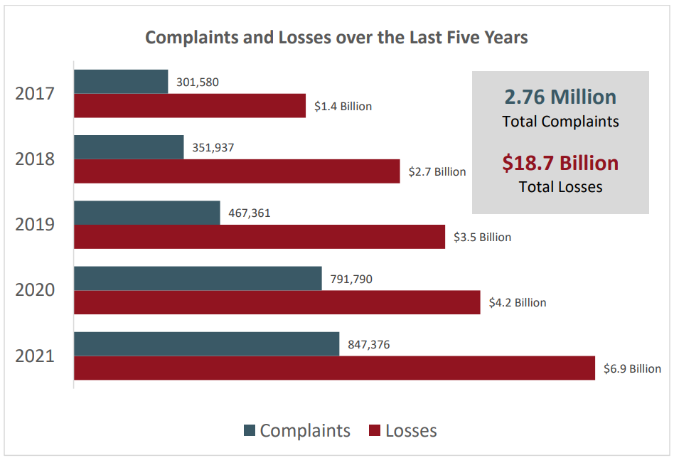
Cyber Attack
Location: Can occur on anywhere in the Central Region, both to private and government servers
Extent: Can range from personal email scams to large scale theft of confidential information or interruption of critical services with a required ransom.
Montana ranked as 49th state in U.S. for victim losses, with $10,107,283 in losses and 48th for number of victims per state, with 1,188 victims.
Probability: Growing rapidly in frequency every year, but difficult to predict due to high variability
Impacts:
Power failure and blackouts
Communication/emergency response failure (9-1-1 attacks)
Personal monetary losses. Populations 60+ experience the greatest losses from cyber-attacks
Leaked confidential information from government serves
Potential attacks on electric vehicles and self-driving cars
Source: The FBI Internet Crime Report 2021
Notes:
Includes rockfall, debris flow as well as slumps
Spring is typical landslide/rockfall season

Slide 78
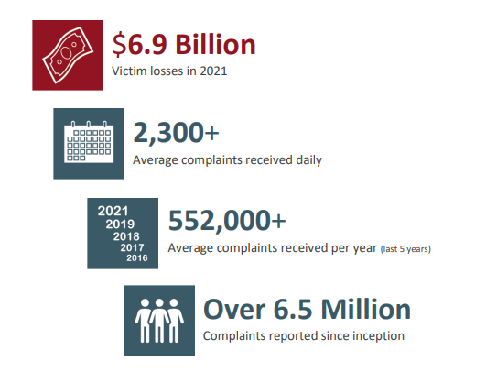
Cyber Attack
Hazard Risk Summary Table
Jurisdiction | Geographic Extent | Probability of Future Occurrence | Potential Magnitude/ Severity | Overall Significance
Blackfeet | Significant | Occasional | Critical | Medium
Blaine | Significant | Occasional | Critical | Medium
Cascade | Significant | Occasional | Critical | Medium
Rocky Boy’s | Significant | Occasional | Critical | Medium
Chouteau | Significant | Occasional | Critical | Medium
Fergus | Significant | Occasional | Critical | Medium
Glacier | Significant | Occasional | Critical | Medium
Hill | Significant | Occasional | Critical | Medium
Judith Basin | Significant | Occasional | Critical | Medium
Liberty | Significant | Occasional | Critical | Medium
Petroleum | Significant | Occasional | Critical | Medium
Phillips | Significant | Occasional | Critical | Medium
Pondera | Significant | Occasional | Critical | Medium
Teton | Significant | Occasional | Critical | Medium
Toole | Significant | Occasional | Critical | Medium
Source: The FBI Internet Crime Report 2021

Slide 79
What do you think the significance of cyber-attack is for your jurisdiction?
ⓘ Start presenting to display the poll results on this slide.

Slide 80
Human Conflict (Terrorism)
Terrorist Attacks in the U.S. 1970-2018
Most common targets
Businesses: 27%
Government: 17%
Private Citizens & Property: 13%
Abortion-related: 9%
Military: 6%
Police: 6%
Religious: 5%

Slide 81
Human Conflict (Terrorism)
The Center for Strategic & International Studies records 980 domestic terrorist attacks in the US since 1994, with sharp growth over the last 10-15 years.

Slide 82
Human Conflict (Active Shooter Incidents)
Active Shooter Incidents in the U.S. 2000-2020
Sources:
FBI Active Shooter Incidents, 20-Year Review 2000-2019
FBI Active Shooter Incidents in the United States 2020

Slide 83
Human Conflict (Active Shooter Incidents)
20-Year Active Shooter Summary (through 2019)

Slide 84
Human Conflict (Civil Unrest)
Defined as any public disturbance involving acts of violence by assemblages of three or more persons, which causes an immediate danger of or results in damage or injury to the property or person of any other individual.
Can include riots, demonstrations, threatening individuals, or assemblies that have become disruptive and may cause harm to others.
There can be many cascading affects of social unrest, including continuity of operations and loss of confidence in government.

Slide 85
Human Conflict (Terrorism, Civil Unrest, etc.)
Hazard Risk Summary Table
Location: Can occur anywhere in the Central Region.
Extent: Can result in significant damage to property and infrastructure, as well as result in injuries and fatalities at a small local scale or across the entire planning area.
Probability: Occasional, 4 active hate groups reported in Montana in 2021 by the Southern Poverty Law Center, in addition to growing numbers of protests across the world in recent years.
Impacts:
Property damage and personal injuries possible​
Continuity of operations may be impacted​
Economic disruptions​
Public confidence in government can be affected​
Jurisdiction | Geographic Extent | Probability of Future Occurrence | Potential Magnitude/ Severity | Overall Significance
Blackfeet | Significant | Unlikely | Critical | Medium
Blaine | Significant | Unlikely | Critical | Medium
Cascade | Significant | Unlikely | Critical | Medium
Rocky Boy’s | Significant | Unlikely | Critical | Medium
Chouteau | Significant | Unlikely | Critical | Medium
Fergus | Significant | Unlikely | Critical | Medium
Glacier | Significant | Unlikely | Critical | Medium
Hill | Significant | Unlikely | Critical | Medium
Judith Basin | Significant | Unlikely | Critical | Medium
Liberty | Significant | Unlikely | Critical | Medium
Petroleum | Significant | Unlikely | Critical | Medium
Phillips | Significant | Unlikely | Critical | Medium
Pondera | Significant | Unlikely | Critical | Medium
Teton | Significant | Unlikely | Critical | Medium
Toole | Significant | Unlikely | Critical | Medium
Notes:
Includes rockfall, debris flow as well as slumps
Spring is typical landslide/rockfall season

Slide 86
What do you think the significance of human conflict is for your jurisdiction?
ⓘ Start presenting to display the poll results on this slide.

Slide 87
MT Central Region Hazard Significance Summary Table : Subregion A
Hazard | Blackfeet Tribe | Cascade | Glacier | Pondera | Teton
Communicable Disease | Medium | Medium | Medium | Medium | Medium
Cyber-Attack | Medium | Medium | Medium | Medium | Medium
Dam Failure | Medium | Medium | Medium | Medium | Medium
Drought | Medium | Medium | Medium | Medium | Medium
Earthquake | Low | Low | Low | Low | Low
Flooding | High | High | Medium | Low | Medium
Hazardous Material Incidents | Low | High | Medium | Low | Low
Human Conflict (Terrorism, Civil Unrest, etc.) | Medium | Medium | Medium | Medium | Medium
Landslide | Low | Low | Medium | Low | Low
Severe Summer Weather | Medium | Medium | Medium | High | Medium
Severe Winter Weather | Medium | Medium | Medium | Medium | High
Tornadoes & Windstorms | Medium | Medium | Medium | High | High
Transportation Accidents | Low | Medium | Low | Low | Low
Volcanic Ash | Low | Low | Low | Low | Low
Wildland and Rangeland Fire | High | Medium | High | Medium | Medium

Slide 88
MT Central Region Hazard Significance Summary Table : Subregion B
Hazard | Rocky Boy’s | Chouteau | Hill | Liberty | Toole
Communicable Disease | Medium | Medium | Medium | Medium | Medium
Cyber-Attack | Medium | Medium | Medium | Medium | Medium
Dam Failure | Medium | Medium | Medium | Medium | Medium
Drought | Medium | Medium | Medium | Medium | Medium
Earthquake | Low | Low | Low | Low | Low
Flooding | Low | Medium | Medium | Medium | Medium
Hazardous Material Incidents | Low | Low | Low | Low | Low
Human Conflict (Terrorism, Civil Unrest, etc.) | Medium | Medium | Medium | Medium | Medium
Landslide | Low | Low | Low | Low | Low
Severe Summer Weather | Medium | Medium | Medium | Medium | Medium
Severe Winter Weather | Medium | High | Medium | High | Medium
Tornadoes & Windstorms | Medium | High | Medium | Medium | Medium
Transportation Accidents | Low | Low | Low | Medium | Medium
Volcanic Ash | Low | Low | Low | Low | Low
Wildland and Rangeland Fire | Medium | Medium | Medium | Medium | Medium

Slide 89
MT Central Region Hazard Significance Summary Table : Subregion C
Hazard | Blaine | Fergus | Fort Belknap | Judith Basin | Petroleum | Phillips
Communicable Disease | Medium | Medium | Medium | Medium | Medium | Medium
Cyber-Attack | Medium | Medium | Medium | Medium | Medium | Medium
Dam Failure | Medium | Medium | Medium | Medium | Medium | Medium
Drought | Medium | Medium | Medium | Medium | Medium | Medium
Earthquake | Low | Low | Low | Low | Low | Low
Flooding | Medium | High | Low | Medium | Low | Medium
Hazardous Material Incidents | Low | Low | Low | Low | Low | Low
Human Conflict (Terrorism, Civil Unrest, etc.) | Medium | Medium | Medium | Medium | Medium | Medium
Landslide | Low | Low | Low | Low | Low | Low
Severe Summer Weather | High | High | Medium | Medium | Medium | Medium
Severe Winter Weather | Medium | High | Medium | Medium | High | Medium
Tornadoes & Windstorms | Medium | High | Medium | Medium | Medium | Medium
Transportation Accidents | Low | Low | Low | Low | Low | Low
Volcanic Ash | Low | Low | Low | Low | Low | Low
Wildland and Rangeland Fire | High | Medium | High | Medium | High | Medium

Slide 90
Mitigation Strategy Update

Slide 91
Mitigation Strategy Update
Goals
General guidelines that explain what you want to achieve
Usually broad policy/vision statements
Objectives (optional)
Define strategies or implementation steps to attain goals
Specific and measurable
Actions
Specific projects/activities to achieve goals & objectives

Slide 92
Mitigation Goals – 2018 Montana SHMP
(etc.)

Slide 93
Mitigation Goals
Cascade County HMP Goals:
Reduce the Impacts from Hazardous Material Incidents
Reduce Impacts from Wildfires
Reduce the Impacts from Severe Weather & Drought
(etc.)
Toole County HMP Goals:
Mitigate natural hazards to reduce the potential for property loss or damage, injury and loss of life in the City of Shelby.
Mitigate natural hazards to reduce the potential for property loss or damage, injury and loss of life in the Town of Sunburst.
Mitigate natural hazards to reduce the potential for property loss or damage, injury and loss of life in the Town of Kevin.
(etc)

Slide 94
Mitigation Goals
Fort Belknap HMP Goals:
Protect the lives, health, and safety of the citizens of the Fort Belknap Reservation before, during, and after a disaster.
Protect and eliminate and/or reduce damages and disruptions to critical facilities, structures, and infrastructure during disasters.
Enhance and protect the communication and warning/notification systems on the reservation.
Promote education and awareness programs, campaigns, and efforts designed to encourage citizens and private and public entities to mitigate and become more resilient to disasters.
Ensure and promote ways to increase government and private sector continuity of services during and after a disaster.
Advocate, support, and promote the continued coordination and integration of disaster planning efforts throughout the reservation.
Advocate, support, and promote the use of laws and local regulations and ordinances aimed to mitigate hazards and to enhance resiliency.

Slide 95
Prior Mitigation Actions
2006 Phillips County HMP

Slide 96
Prior Mitigation Actions
Not Started: Work has not begun
In Progress: Work has begun but is not completed
Completed: The action has been finished
Annual Implementation: Ongoing with no specific end date
Deleted: The action is no longer relevant or cancelled due to changing priorities, lack of funds, etc.
There is no requirement or expectation to have completed any/all previous actions.

Slide 97
Mitigation Actions Update – New Actions
Begin thinking of new action ideas
Each jurisdiction will need at least one NEW action per hazard,
A breadth of actions that cover priority hazards
Use updated risk assessment as basis
Possible new actions will be suggested e.g.:
Critical facility protection
Outdoor warning
Mitigation capability improvements
Will be the focus of next meeting

Slide 98
Please indicate which weeks work for you to attend the mitigation workshops
ⓘ Start presenting to display the poll results on this slide.

Slide 99
Next Steps

Slide 100
Next Steps
Please return plan update guide input where outstanding
Provide input on mitigation action status on form
Start thinking of ideas for new mitigation actions
Stay informed by email of upcoming meetings (TBD)
Review results public survey results
Review draft HIRA section of plan when available
For yellow highlighted gaps where applicable
Review for jurisdiction specifics, mitigation ideas

Slide 101
Project Tasks and Schedule
Project Milestones | Anticipated Timeline
Meeting #2 HIRA review | August
HIRA Draft for HMPC review | September
Meeting #3 Mitigation Strategy | October
HMPC Review Draft | November
Public Review Draft | December
DHSEM Review Draft | January – February 2023
Final Plan for FEMA Review (estimated) | March – April 2023
Final Approved HMP for local adoption | May-July 2023

Slide 102
Don’t Leave without Typing Your Name, Title, and Affiliation in Chat Box!

Slide 103
Questions?
Central Region Project Manager/
Mitigation Coordinator
Hannah Shultz
Montana DES
Hannah.Shultz@mt.gov
406-292-1092
Project Manager
Jeff Brislawn
Wood Environment & Infrastructure Solutions, Inc
Jeff.brislawn@woodplc.com
303-704-5506
Lead Planner
Scott Field
Wood Environment & Infrastructure Solutions, Inc
Scott.field@woodplc.com
720-569-9266

